Slide 1


Year 2 Curriculum Workshop
2024/25

Slide 2
Welcome to Year 2
Class 5: Mrs Edwards, Miss Dillon, Mr Day, Miss Dixon, Miss Raiswell
Class 6: Miss Colclough, Miss Dillon, Miss Shorten

Slide 3


Slide 4
Aims:
To understand expectations within each year group
To identify ways to support your child's learning at home

Slide 5
REPORTING TO PARENTS
We will continue to use the phrases:
  Working towards age related expectation WTS
  Working at age related expectation EXS
  Working well within age related expectations
  We use these terms to describe your child’s progress against the curriculum for their year group

Slide 6
Homework
On Friday, homework will be set and then handed back in by the following Thursday so that new homework can be set.
Each week there will be a Maths/English task linked to what we have learnt in class that week. The children should read to an adult, a minimum of three times a week for 20 minutes.
Please remember to access the many online resources available to enhance your child’s learning too.

Slide 7

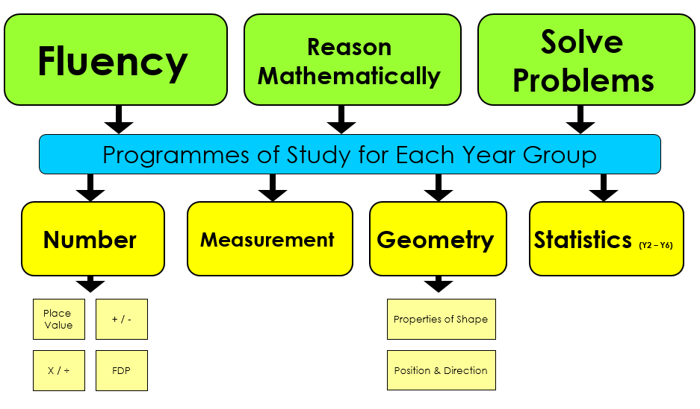
Maths

Slide 8
How we teach Maths
Practical based
Concrete, Pictorial, Abstract
Strong number knowledge
Can they apply it?

Slide 9

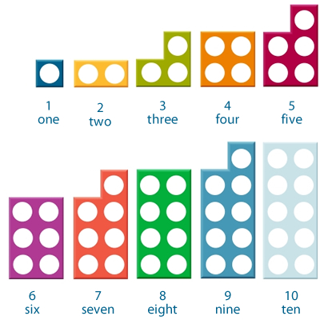
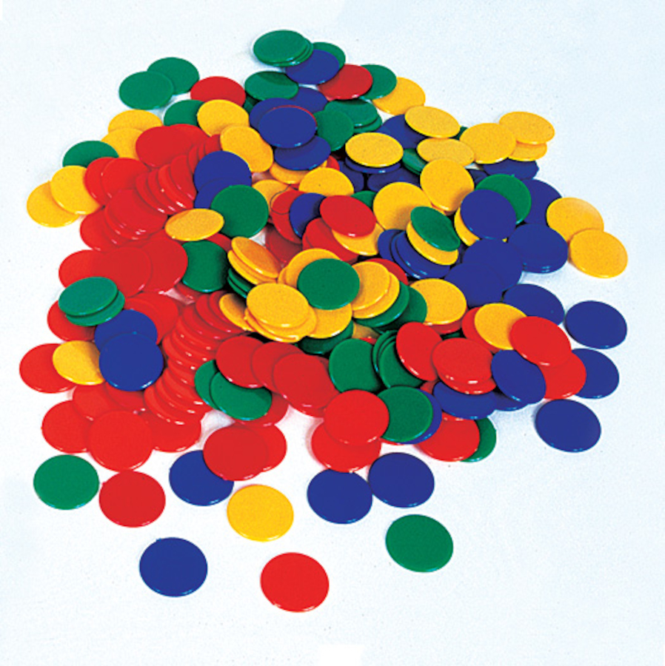
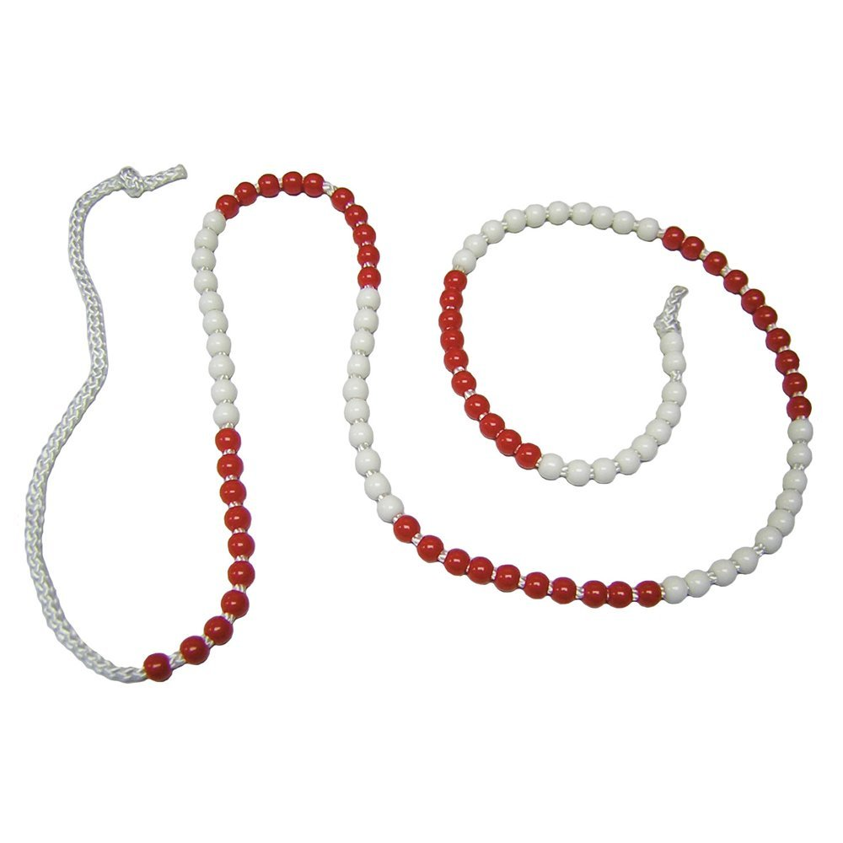
Concrete
We give all our children hands on experiences using real objects. It is the foundation for conceptual understanding.

Slide 10
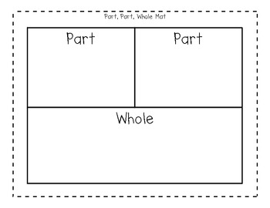
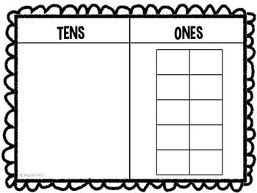

Pictorial
Using representations, such as a diagram or a picture of the problem.

Slide 11
Abstract
Children are now able to represent problems using notation, for example: 12 + 6 =

Slide 12
Fluency
Rapid recall of number facts
Year 2: All number bonds to 20
Counting in 2’s, 5’s and 10’s
2, 5 and 10 times tables

Slide 13
HOW CAN YOU HELP YOUR CHILD AT HOME?
Time
Number bonds
Practical use of maths at home e.g. money, recipes, planning journeys etc
Board games/ card games
I pad/ computer games
BBC Super movers - https://www.bbc.co.uk/sport/football/supermovers

Slide 14


Slide 15
The four areas of the English Curriculum
English
Spoken language
Reading
SPaG/ Phonics
Writing

Slide 16
Spoken Language
Drama and role play
Class assemblies
Reading aloud
Talk partners in class – Think, Pair, Share

Slide 17
Reading
A solid foundation in reading is crucial to your child’s success as they progress through primary school, into secondary school and then in later life.

Slide 18
Our aims are to…
Encourage children to develop a love of books
Teach children how to decode words using phonics and other strategies
Give children the opportunity to talk about books that they have read
Help children to develop the skills of deduction and inference (reading between the lines)

Slide 19
Reading in school
The children will read in small groups to an adult throughout the week. They will use books at their appropriate level from either the Little Wandle scheme or Accelerated Reader.

Slide 20

Reading at home
Reading with siblings
Joining the library
Bedtime stories
Re-reading books
Reading in the environment
Allowing your child to see you reading

Slide 21
Year 2 Phonics
Four key principles:
Sounds (phonemes) are represented by letters (graphemes)
A sound (phoneme) can be represented by more than one letter
We have different ways to spell different sounds
Occasionally we use the same letters to represent different sounds

Slide 22
Year 2 Spelling
Most children start on Phase 5 review.
Then move onto Support for Spelling which focuses on spelling patterns and rules.

Slide 23


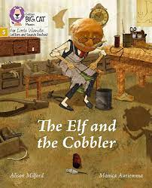
Writing
Quality text
Model shared writing
Draft and edit
Create a finished product

Slide 24
Sentence Structure
Capital letters
Full stop at the end of the sentence
Finger spaces
Neat handwriting
Does it make sense??

Slide 25
Handwriting
Letter formation
Letter size
Ascenders and descenders
Capital letters

Slide 26
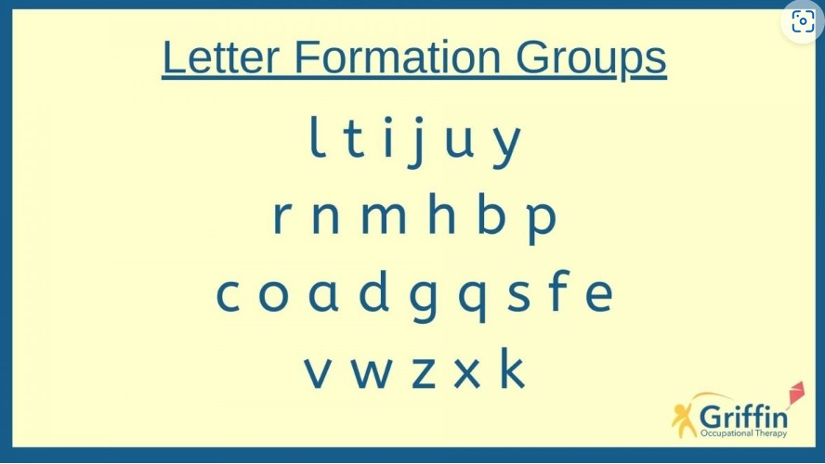
Handwriting

Slide 27
SPAG KS1
S is for spelling- Spellings of the week and phonics
P is for punctuation
. A ? ! ,
G is for grammar- word classes (nouns, verbs, adjectives, adverbs)

Slide 28
How can you support your child?
Reading for enjoyment - children reading, children hearing an adult read
Regular reading with discussion - ask questions about what your child is reading
Discuss vocabulary
Encourage reading a range of genres eg. Instruction manuals, newspapers, recipes etc
Online spelling games/ making spelling fun- share techniques that have worked, e.g. Topmarks
Using spelling words in sentences- applying what they are learning in context
Regular writing practise – make it fun!

Slide 29
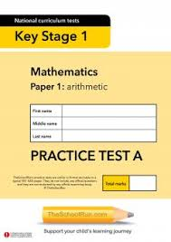
KS1 SATs
No longer statutory
Used as another form of assessment in Year 2

Slide 31




Behaviour curriculum in a nutshell
When I put my hand up I am ready to show Fantastic Contributing:
● Listening to the class teacher or whoever is speaking
● Considering my responses before sharing
● Putting my hand up so I know my teacher knows I want to contribute during whole class discussions
● Sharing answers/contributions in a clear voice using full sentences
● Building on what others have said
Arriving at school at the beginning of the day
I arrive on time to school.
I walk calmly to my classroom.
I greet staff with a smile and a ‘good morning’.
I put my personal belongings in the correct place.
I know that once I have entered the classroom, I do not leave again unless I have asked a member of staff.
I sit down in my seat as soon as I have entered the classroom and begin the morning task.
I will show Fantastic Listening in class.
● S - Sitting or standing up straight
● T - Tracking the teacher
● A - Attention at all times
● R - Respect towards others
WHY? To ensure everybody is able to learn without distractions.
When I see the Silent Signal I will:
● S - Sit or stand up straight
● T - Track the teacher
● A - Attention at all times
● R - Respect towards others
Around school I will show Fantastic Walking:
•Facing forward
•Walking in a straight line
•Hands by side
•Without talking
•Without leaning on walls whilst waiting
WHY? To make sure the learning of other children is not disrupted as people move around school.
Using good manners
I always say ‘please’ when I am asking for something.
I always say ‘thank you’ when I receive something or someone does something nice for me.
I say ‘Good morning/afternoon’ to adults if spoken to.
I know that it is important to show gratitude to others by thanking people for what they have done for me.
I know that a calm and polite tone is respectful.

Slide 32
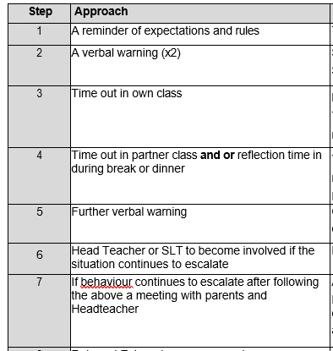
Behaviour Policy

Slide 33
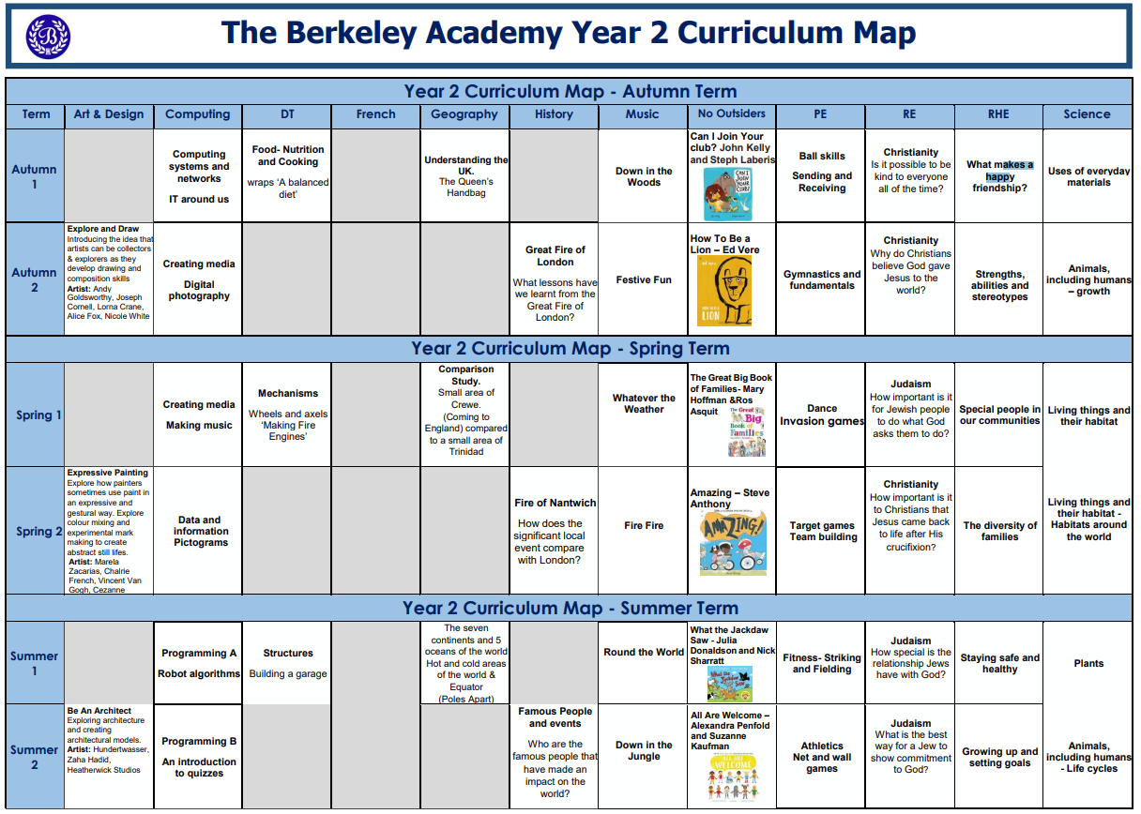

Slide 34
Thank you for joining us
If you have any questions please feel free to email or write a note in your child’s planner.

