Slide 1


Year 6 Curriculum Workshop
2025/26

Slide 2
Welcome to Year 6
Class 13: Mr Wagg
Class 14: Mr Birchenough
Other staff members: Miss Doran

Slide 3


Slide 4
Aims:
To understand expectations within each our group
To identify ways to support your child's learning at home

Slide 5
Parent Handbook
You will have received a link to the Parent Handbook. It is also available on the website – under the Home tab.
Please read this and share the relevant parts with your child.
The expectations that the school follow are set out in this handbook. For example - uniform expectations, water bottles and snacks.

Slide 6
REPORTING TO PARENTS
We will continue to use the phrases:
  Working towards age related expectation WTS
  Working at age related expectation EXP
  We use these terms to describe your child’s progress against the curriculum for their year group

Slide 7
Homework
On Friday, homework will be set and then handed back in by the following Friday so that new homework can be set. Each week there will be a Maths task linked to what we have learnt in class that week. There is also an English task, which may include elements of Reading comprehension, SpaG and Writing
Reminder – The opportunity to read at least three times per week is vital in terms of helping your child develop fluency in their reading
Please remember to access the many online resources available to enhance your child’s learning too.

Slide 8

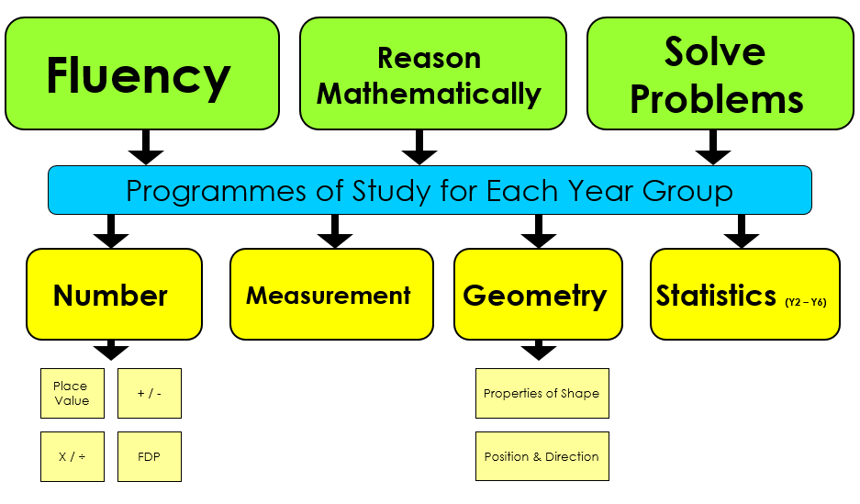
Maths

Slide 9
How we teach Maths
Practical based
Concrete, Pictorial, Abstract
Strong number knowledge
Can they apply it?

Slide 10
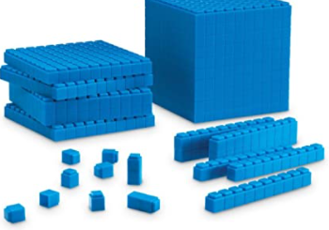
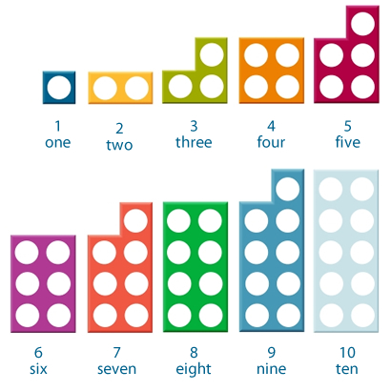
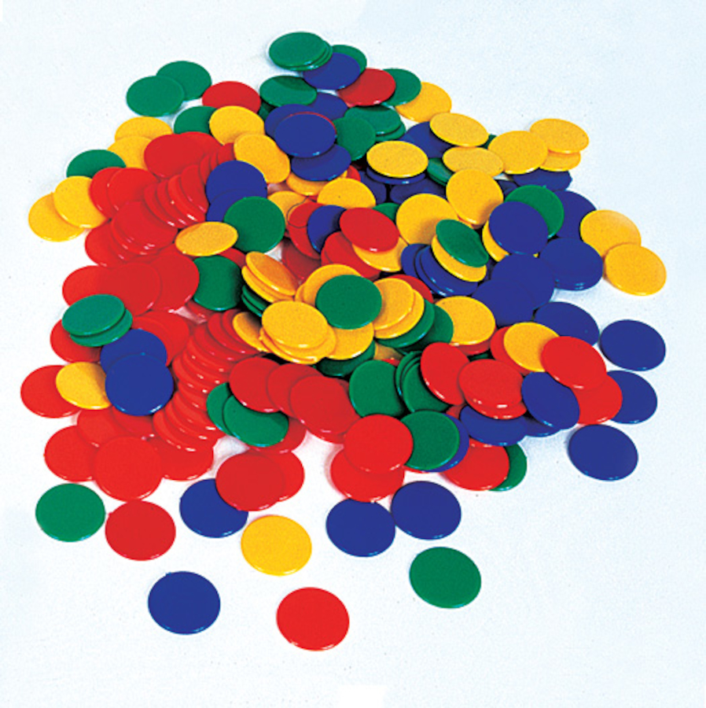
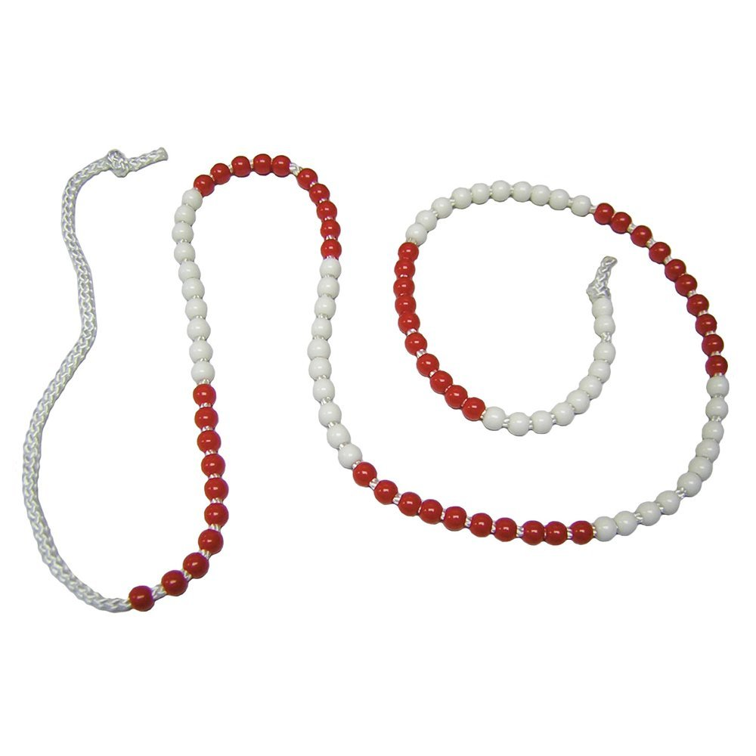
Concrete
We give all our children hands on experiences using real objects. It is the foundation for conceptual understanding.

Slide 11
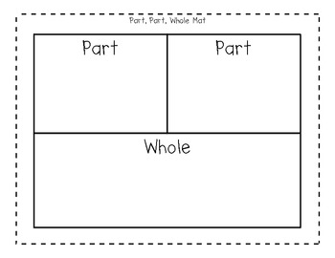
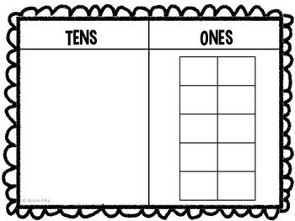

Pictorial
Using representations, such as a diagram or a picture of the problem.

Slide 12
Abstract
Children are now able to represent problems using notation, for example: 2346 + 2197 =

Slide 13
Fluency
Rapid recall of number facts
Year 6: All multiples and factors
Secure knowledge and rapid recall of
all times tables

Slide 14
HOW CAN YOU HELP YOUR CHILD AT HOME?
Time
Number bonds
Practical use of maths at home e.g. money, recipes, planning journeys etc
Board games/ card games
I pad/ computer games
BBC Bitesize https://www.bbc.co.uk/bitesize
MTC check

Slide 15


Slide 16
The four areas of the English Curriculum
English
Spoken language
Reading
SPaG
Writing

Slide 17
Spoken Language
Drama and role play
Class assemblies
Reading aloud
Talk partners in class

Slide 18
Reading
A solid foundation in reading is crucial to your child’s success as they progress through primary school, into secondary school and then in later life.

Slide 19
Our aims are to…
Encourage children to develop a love of books
Teach children how to decode words using phonics and other strategies
Give children the opportunity to talk about books that they have read
Help children to develop the skills of deduction and inference (reading between the lines)

Slide 20
Reading in school
Children will have a daily reading lesson where they will be taught reading skills and given the opportunity to respond to texts. In Year 6 we spend time looking at formal written comprehensions in preparation for SATS.
We also spend time each week hearing your children read and discussing the books they enjoy to help develop their fluency and love of reading.

Slide 21

Reading at home
Reading with siblings
Joining the library
Bedtime stories
Re-reading books
Reading in the environment
Allowing your child to see you reading

Slide 22



Writing
Quality text
Model shared writing
Draft and edit
Create a finished product

Slide 23
SPAG KS2
Sp is for spelling- Spellings of the week
P is for punctuation
. A ? ! ,
G is for grammar- word classes (nouns, verbs, adjectives, adverbs)

Slide 24
How can you support your child?
Reading for enjoyment - children reading, children hearing an adult read
Regular reading with discussion - ask questions about what your child is reading
Discuss vocabulary
Encourage reading a range of genres eg. Instruction manuals, newspapers, recipes etc
Spelling? Spelling? Spelling?
Online spelling games/ making spelling fun- share techniques that have worked, e.g. Topmarks Check spellings against the Yr3/4 and 5/6 spelling lists online.
Using spelling words in sentences- applying what they are learning in context

Slide 25


Slide 26
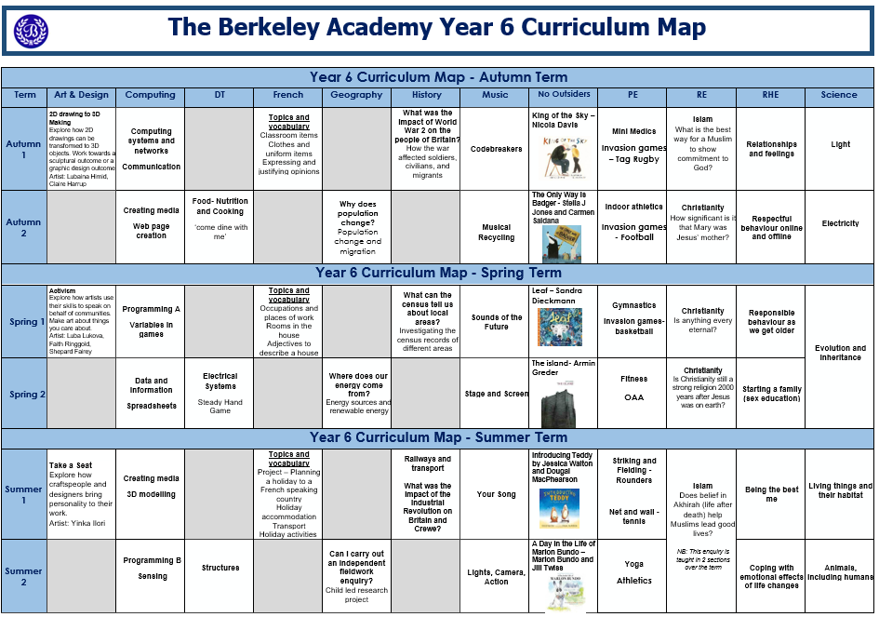

Slide 27
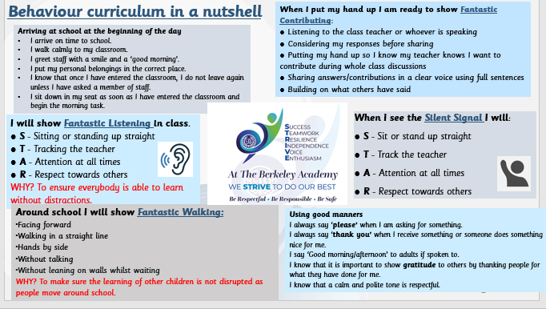
Behaviour Policy

Slide 28
SATs Information
Monday 11th May - SpaG
Tuesday 12th May - Reading
Wednesday 13th May – Maths 1&2
Thursday 14th May – Maths 3

Slide 29
Thank you for joining us
If you have any questions please feel free to email or speak to us.
admin@berkeley.cheshire.sch.uk
With your child’s name and class as the subject

