Slide 1


Year 6
Curriculum Workshop
2026-27

Slide 2
Welcome to Year 6
Class 13: Mr Wagg
Class 14: Mr Birchenough
Other staff members: Miss Doran, Mrs Veale, Miss Shorten

Slide 3

Aims:
To understand expectations in Year 6
To identify ways to support your child's learning at home

Slide 4

Notes:
Importance of living our school values
RULES too

Slide 5
Parent Handbook
It is available on the website – under the ‘Our School’ tab.
Please read this and share the relevant parts with your child.
The expectations that the school follow are set out in this handbook.
Discuss – behaviour, uniform expectations, water bottles and snacks, etc Allergies (make sure we know about them)
Notes:
Ask for support – as staff we will be holding the standards set out in the handbook

Slide 6
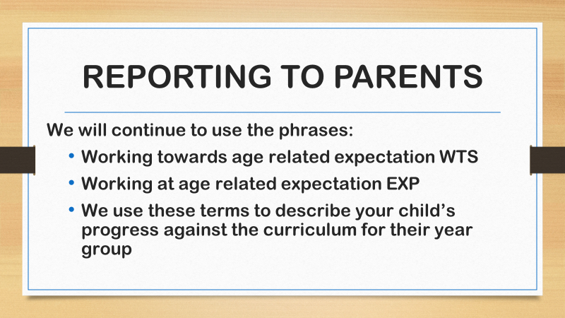

Slide 7
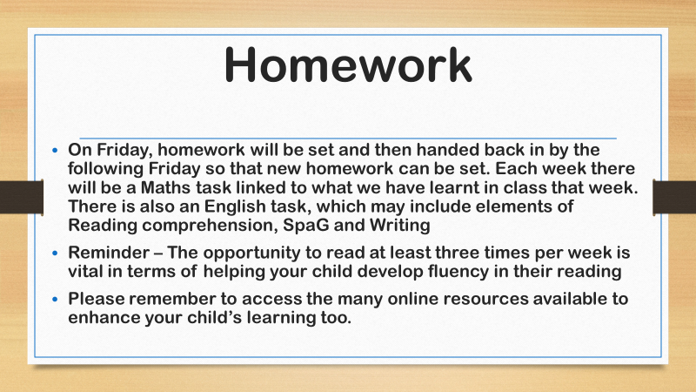

Slide 8
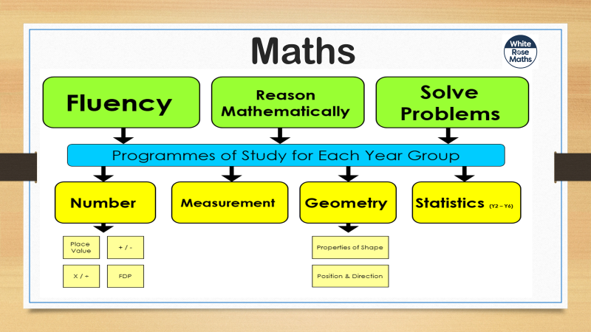

Slide 9
How we teach Maths
Practical based
Concrete, Pictorial, Abstract
Strong number knowledge
Can they apply it?

Slide 10
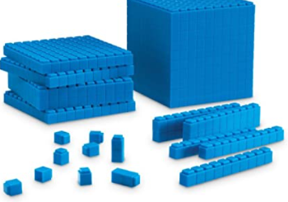
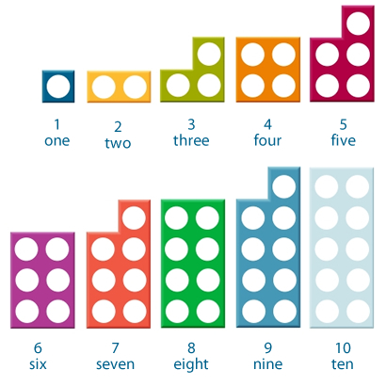


Concrete
We give all our children hands on experiences using real objects. It is the foundation for conceptual understanding.

Slide 11
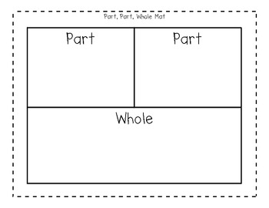
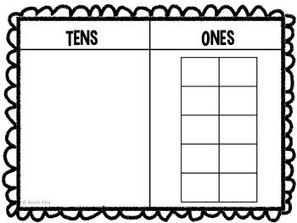

Pictorial
Using representations, such as a diagram or a picture of the problem.

Slide 12
Abstract
Children are now able to represent problems using notation, for example:
2,351 x 12 =

Slide 13
Fluency
Rapid recall of number facts
Year 6: All multiples and factors and a secure knowledge and rapid recall of all times tables

Slide 14
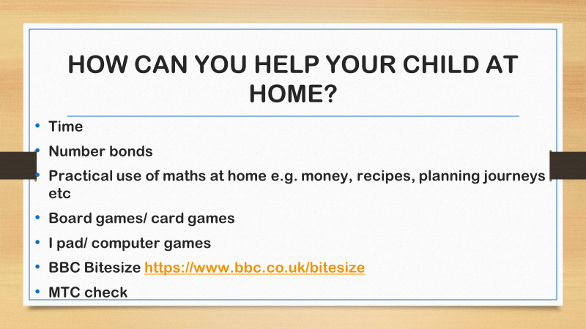

Maths
How we teach Maths
How parents can support
Websites / log in / etc (add QR codes)
MENTION any Statutory assessments

Slide 15


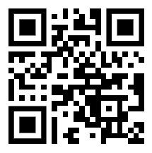
Maths Websites
Times Tables Rockstars
Sumdog
Hit The Button
Mathsbot

Slide 16
English
Spoken Language
Word reading
Comprehension
Writing – handwriting, grammar, spelling and composition

Slide 17
Spoken Language
Drama and role play
Class assemblies
Reading aloud
Talk partners in class

Slide 18
Reading
A solid foundation in reading is crucial to your child’s success as they progress through primary school, into secondary school and then in later life.

Slide 19
Our aims are to…
Encourage children to develop a love of books
Give children the opportunity to talk about books that they have read
Help children to develop the skills of deduction and inference (reading between the lines)

Slide 20
Reading in school
Reading is taught daily, where children are provided with a wide range of texts.
Children will learn to read carefully, skim and scan for evidence to support their answers and develop their skills to answer a variety of comprehension questions.
Could you support reading in school? Volunteer/mystery reader.

Slide 21
Little Wandle Fluency
We will be following the Little Wandle Fluency programme.
This consists of an advanced extension of chapter books.
As children move from F11 through F15, the word count increases alongside the complexity of the language, ideas, and sentence structures.
Once a book has been read, children will be able to bring it home to share with their parents.
Books will be signed out to each child and need to be returned after one week.
Books will need to be replaced by parents if lost or returned damaged.

Slide 22

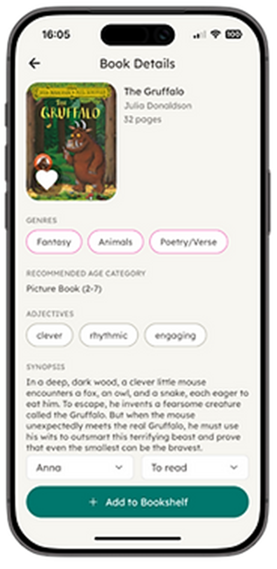
Pageticker: Our Digital Reading Record.
Pageticker helps home and school work together to support your child’s reading journey.
At home, parents/carers can record:
Books read – what your child has been reading
Enjoyment & reviews – what they thought of the book
Comments & observations – confidence, fluency, expression or understanding
Difficulties or tricky words – anything they found challenging
Reading progress – pages read or books completed
This is something that parents record not children. How often and how much detail you record is up to you.

Slide 23
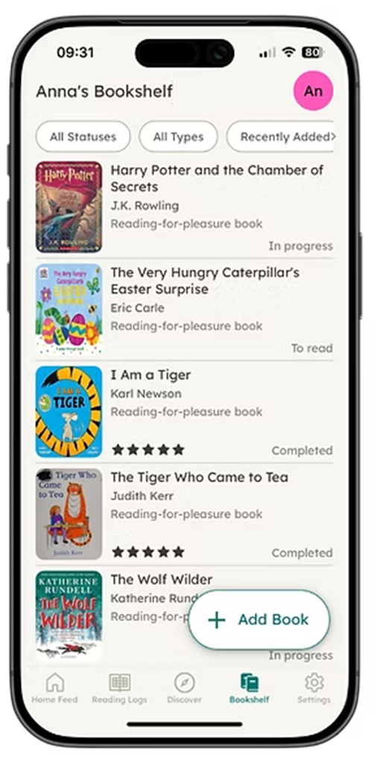
We will use Pageticker alongside our reading assessments to build a fuller picture of your child as a reader.
We will use it to:
Monitor reading progress between home and school
Record the Little Wandle books lent to your child as part of their reading progression
Identify children who may need extra support or encouragement
Understand reading interests, confidence and challenges
Celebrate reading achievements.
Help inform the books, support and next steps that are appropriate for each child.
If you haven’t already activated your account, your password will have expired so a new letter will be given to you.

Slide 24
Writing
Quality text
Writing for a purpose
Model shared writing
Re-read own writing
Letter formation
Grammar and spelling
Sentence structure

Slide 25
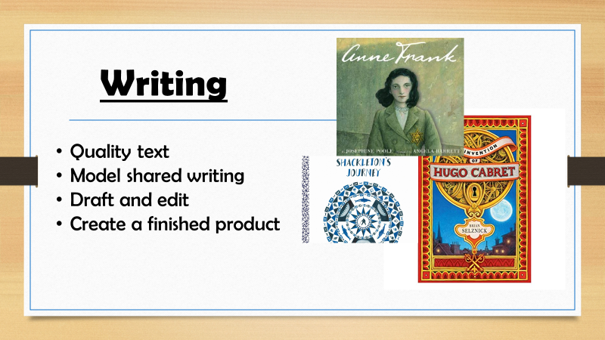
Writing
Quality text
Writing for a purpose
Model shared writing
Re-read own writing
Letter formation
Grammar and spelling
Sentence structure

Slide 26
SPAG KS2
S is for spelling
P is for punctuation
. A ? ! , “ ” ‘ ( ) -
G is for grammar- word classes (nouns, verbs, adjectives, adverbs, parenthesis, relative clauses)

Slide 27
How can you support your child?
Reading for enjoyment - children reading, children reading out loud and children hearing an adult read
Regular reading with discussion - ask questions about what your child is reading
Discuss vocabulary
Encourage reading a range of genres eg. Instruction manuals, newspapers, recipes etc
Online spelling games/ making spelling fun- share techniques that have worked, e.g. Topmarks
Using spelling words in sentences- applying what they are learning in context
Encouraging the use of proper English when speaking at home

Slide 28
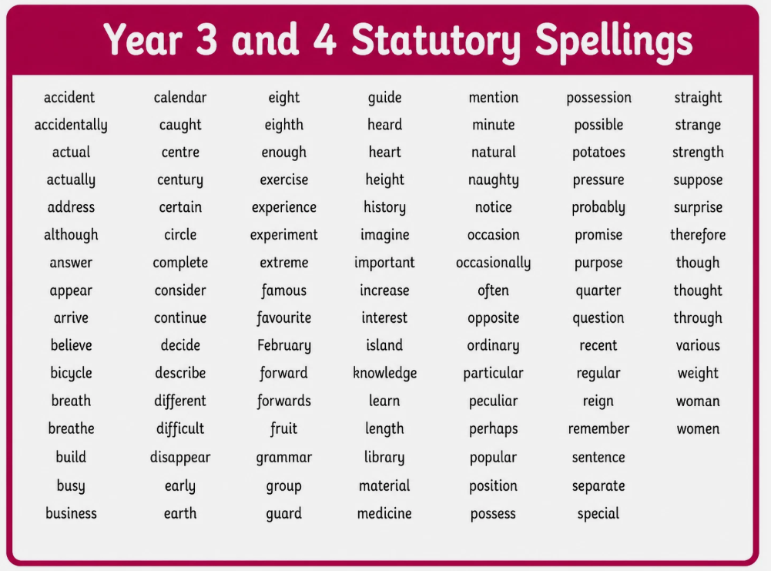
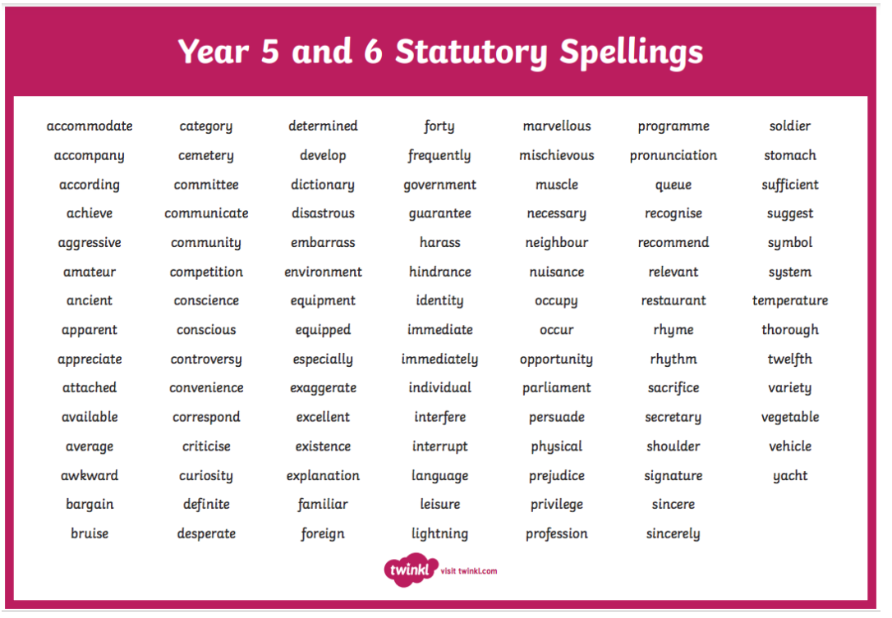
Spellings

Slide 29
Other areas of learning
Science
History
Geography
Art
Design and Technology
Computing
French
Music
Physical Education
Religious Education
Relationship Health Education (RHE)
Personal, Social, Health and Economic (PSHE)
KIVA
No Outsiders
Art of Brilliance

Slide 30

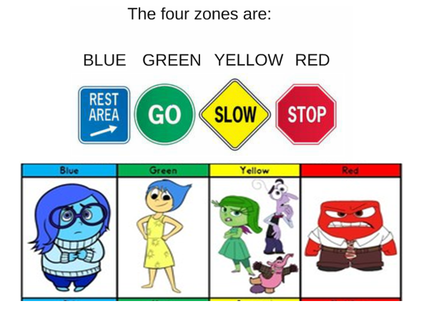
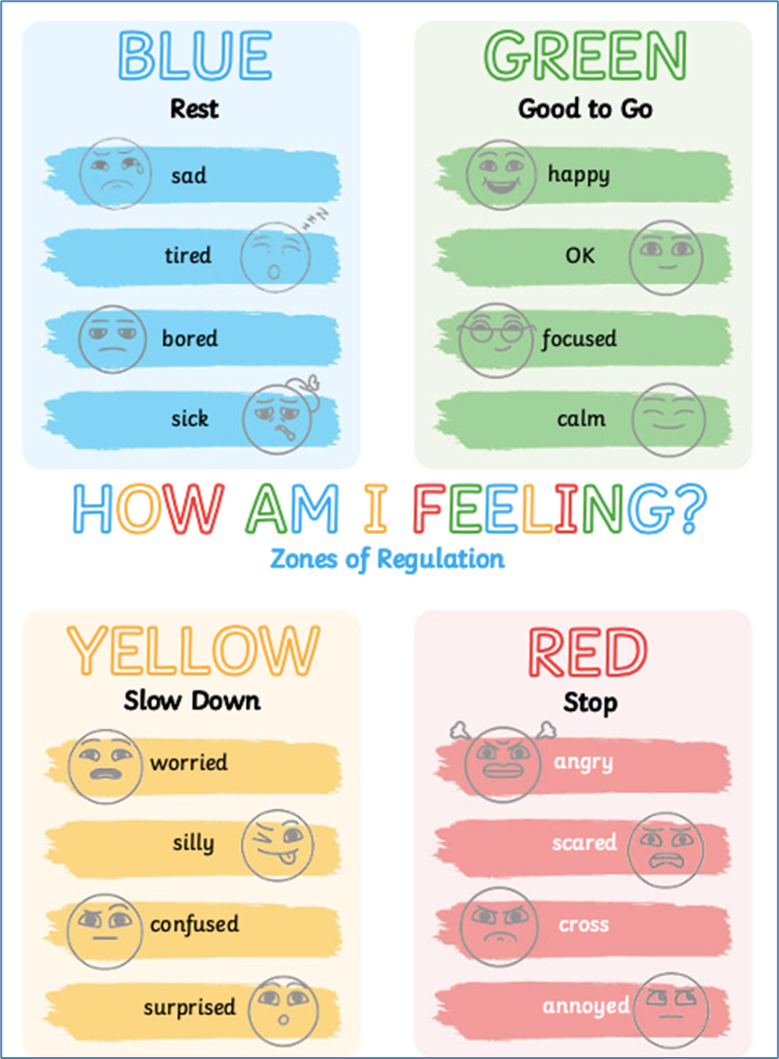

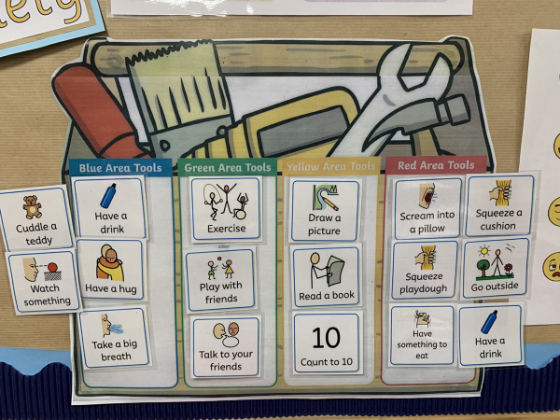
Zones of Regulation
How we can work together:
• Name emotions and validate feelings​
• Discuss which zone your child may be in​
• Practice calming and self-regulation strategies​
• Use a common language at home and school​

Slide 31
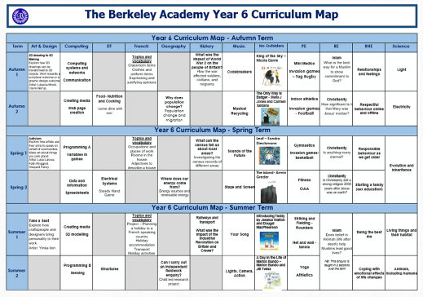
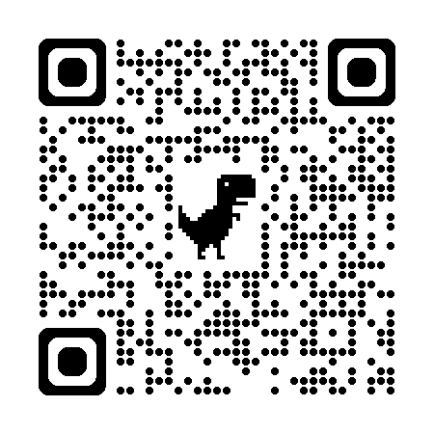
Website
Curriculum maps
Class page
Newsletter / Letters
Parent Handbook

Slide 32


Slide 33
SATs Information
Monday 10th May - SpaG
Tuesday 11th May - Reading
Wednesday 12th May – Maths 1&2
Thursday 13th May – Maths 3

Slide 34
Trips in Year 6
York – June 2027

Slide 35
Communication
Open door policy
Before / after school is best
Email admin@berkeley.cheshire.sch.uk
Please be mindful we have a full teaching timetable so may not be able to call during the school day.
Partnership is key
Class teacher first port of call

Slide 36
Thank you for joining us
If you have any questions please feel free come and speak to us.

