Slide 1


Year 5 Curriculum Workshop
2024/25

Slide 2
Welcome to Year 5
Class 11: Miss Talbot
Class 12:Mrs Moffett and Mr Harrison
Mrs Veale and Miss Shorten will be working in Class 12
Mrs Machin will be supporting both classes.

Slide 3


Slide 4
Aims:
To understand expectations within each year group
To identify ways to support your child's learning at home

Slide 5
REPORTING TO PARENTS
We will continue to use the phrases:
  Working towards age related expectation WTS
  Working at age related expectation EXP
  Working well within age related expectations
  We use these terms to describe your child’s progress against the curriculum for their year group

Slide 6
Homework
On Friday, homework will be set and then handed back in by the following Friday so that new homework can be set.
Each week there will be a Maths task linked to what we have learnt in class that week. There will also be a reading comprehension or a SPaG activity.
We also ask for children to read at least three times a week at home.
Please remember to access the many online resources available to enhance your child’s learning too.

Slide 7

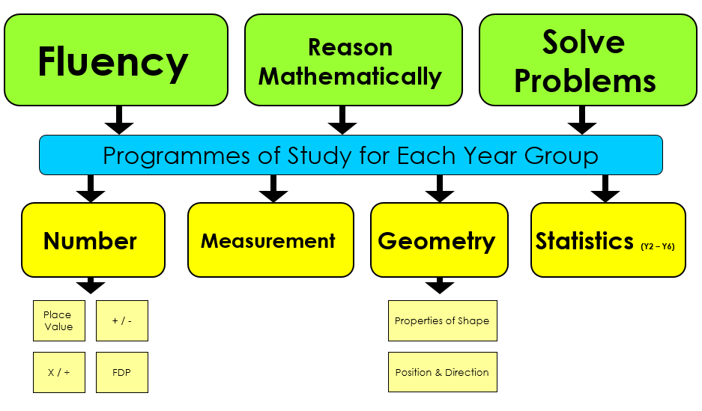
Maths

Slide 8
How we teach Maths
Practical based
Concrete, Pictorial, Abstract
Strong number knowledge
Can they apply it?

Slide 9
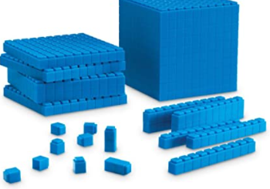
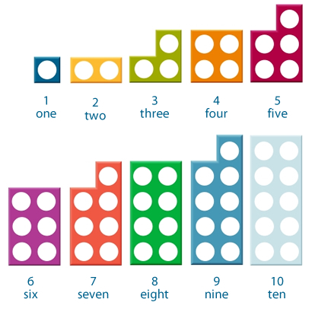
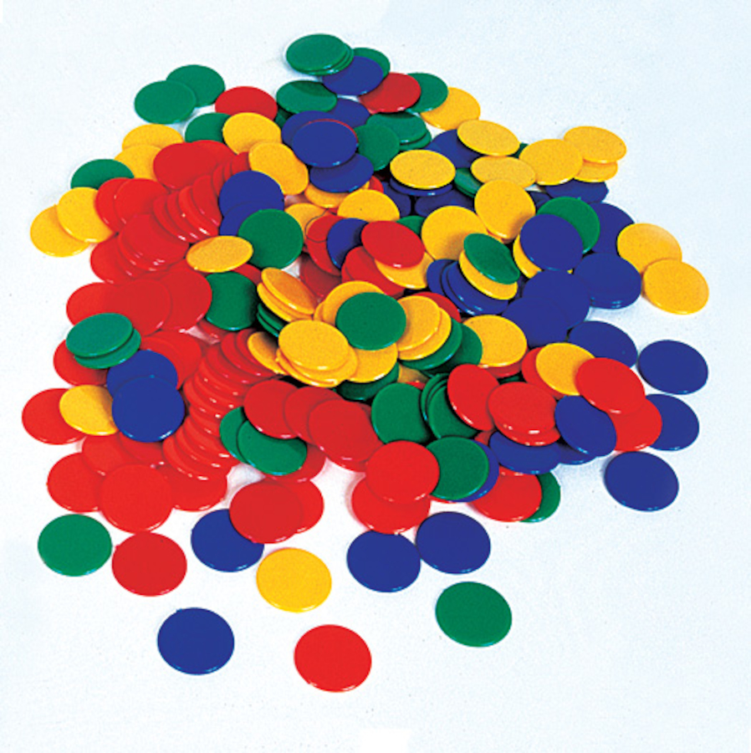
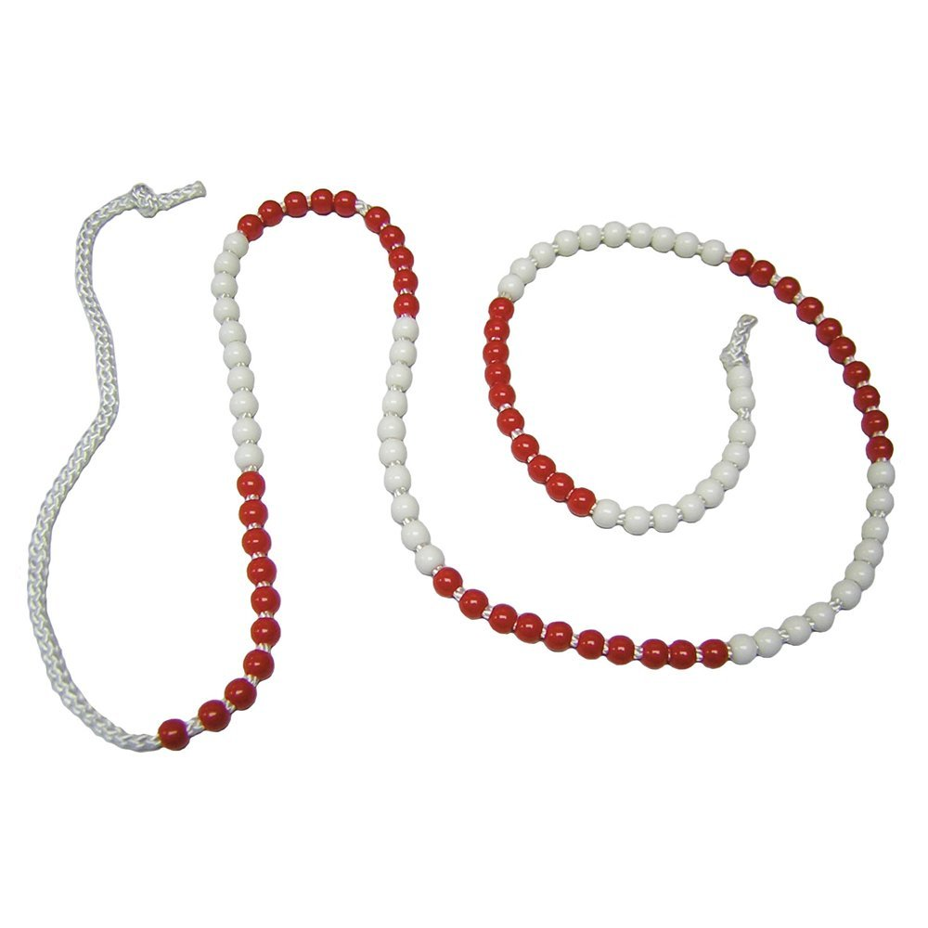
Concrete
We give all our children hands on experiences using real objects. It is the foundation for conceptual understanding.

Slide 10
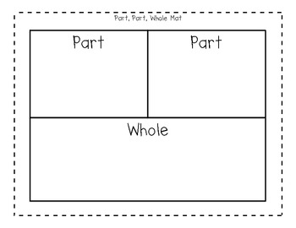
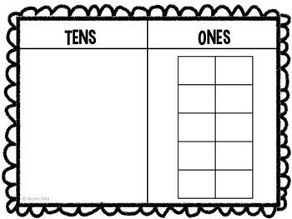

Pictorial
Using representations, such as a diagram or a picture of the problem.

Slide 11
Abstract
Children are now able to represent problems using notation, for example:
2,351 x 12 =

Slide 12
Fluency
Rapid recall of number facts
Year 5: Multiplication and related division facts
Using known number facts
Associating number bonds

Slide 13
HOW CAN YOU HELP YOUR CHILD AT HOME?
Times tables
Developing their mental strategies for addition, subtraction, multiplication and division.
Telling the time
Days, weeks, months and years

Slide 14


Slide 15
The four areas of the English Curriculum
English
Spoken language
Reading
SPaG/ Phonics
Writing

Slide 16
Spoken Language
Drama and role play
Class assemblies
Reading aloud
Talk partners in class
Talk for Writing

Slide 17
Reading
A solid foundation in reading is crucial to your child’s success as they progress through primary school, into secondary school and then in later life.

Slide 18
Our aims are to…
Encourage children to develop a love of books
Give children the opportunity to talk about books that they have read
Help children to develop the skills of deduction and inference (reading between the lines)

Slide 19
Reading in school
Reading is taught daily, where children are provided with a wide range of texts.
Children will learn to read carefully, skim and scan for evidence to support their answers and develop their skills to answer a variety of comprehension questions.

Slide 20

Reading at home
Reading with siblings
Joining the library
Bedtime stories
Re-reading books
Allowing your child to see you reading
Bringing a reading book and their reading diary to school everyday

Slide 21


Writing
Quality text
Model shared writing
Draft and edit
Create a finished product

Slide 22
SPAG KS2
S is for spelling
P is for punctuation
. A ? ! , “ ” ‘ ( ) -
G is for grammar- word classes (nouns, verbs, adjectives, adverbs, parenthesis, relative clauses)

Slide 23
How can you support your child?
Reading for enjoyment - children reading, children reading out loud and children hearing an adult read
Regular reading with discussion - ask questions about what your child is reading
Discuss vocabulary
Encourage reading a range of genres eg. Instruction manuals, newspapers, recipes etc
Online spelling games/ making spelling fun- share techniques that have worked, e.g. Topmarks
Using spelling words in sentences- applying what they are learning in context
Encouraging the use of proper English when speaking at home

Slide 24


Slide 26
Thank you for joining us
If you have any questions please feel free to speak to us on the door, email or write a note in your child’s planner.

