Slide 2
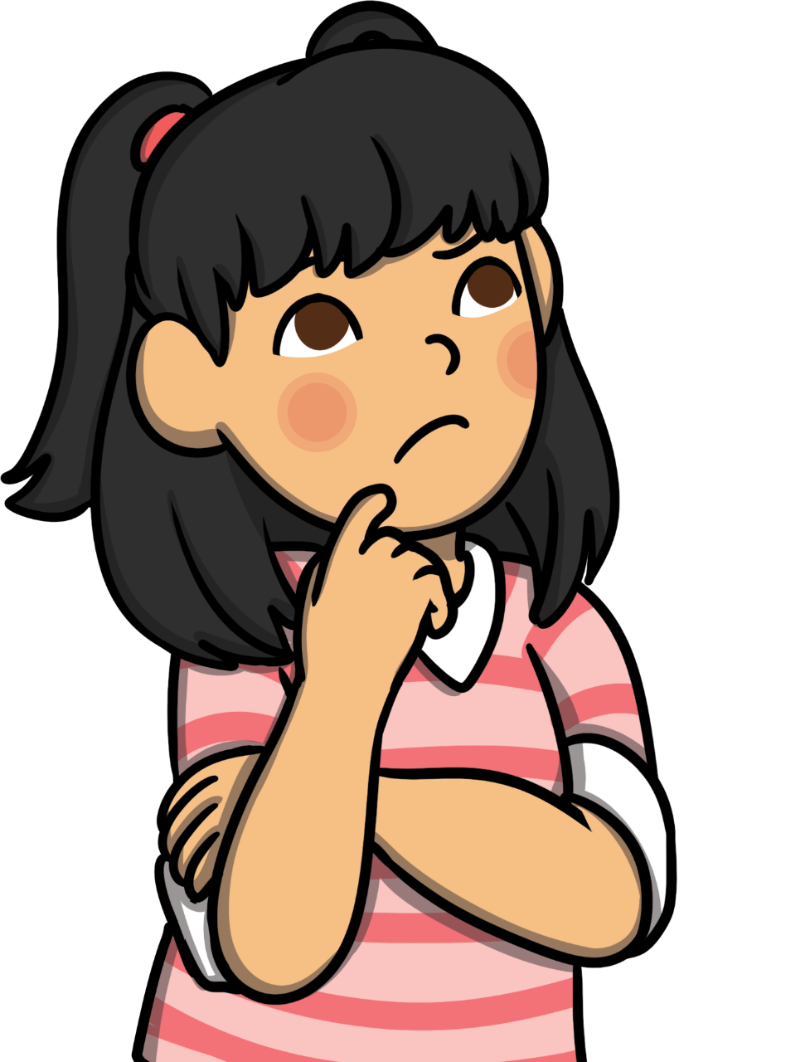
Passover
What do you already know about Passover?

Slide 3
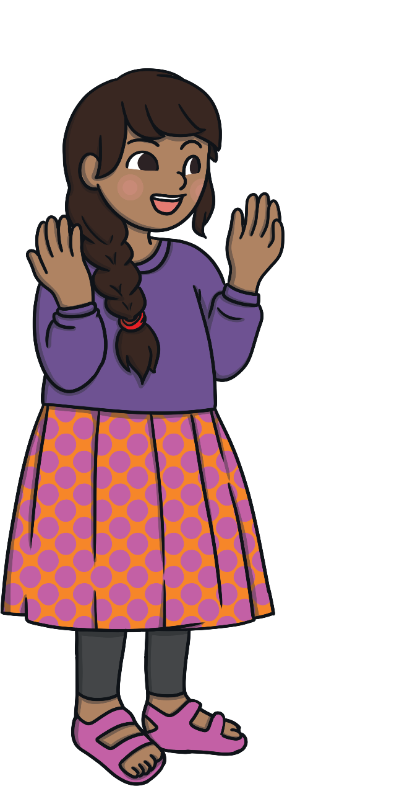
What Is Passover?
  Passover is one of the most important
  festivals in the Jewish year.
Passover is called Pesach in Hebrew.
Jewish – a person whose religion is Judaism
Click on the words in bold to find out more.
Hebrew – an ancient language that is the official language of Israel

Slide 4
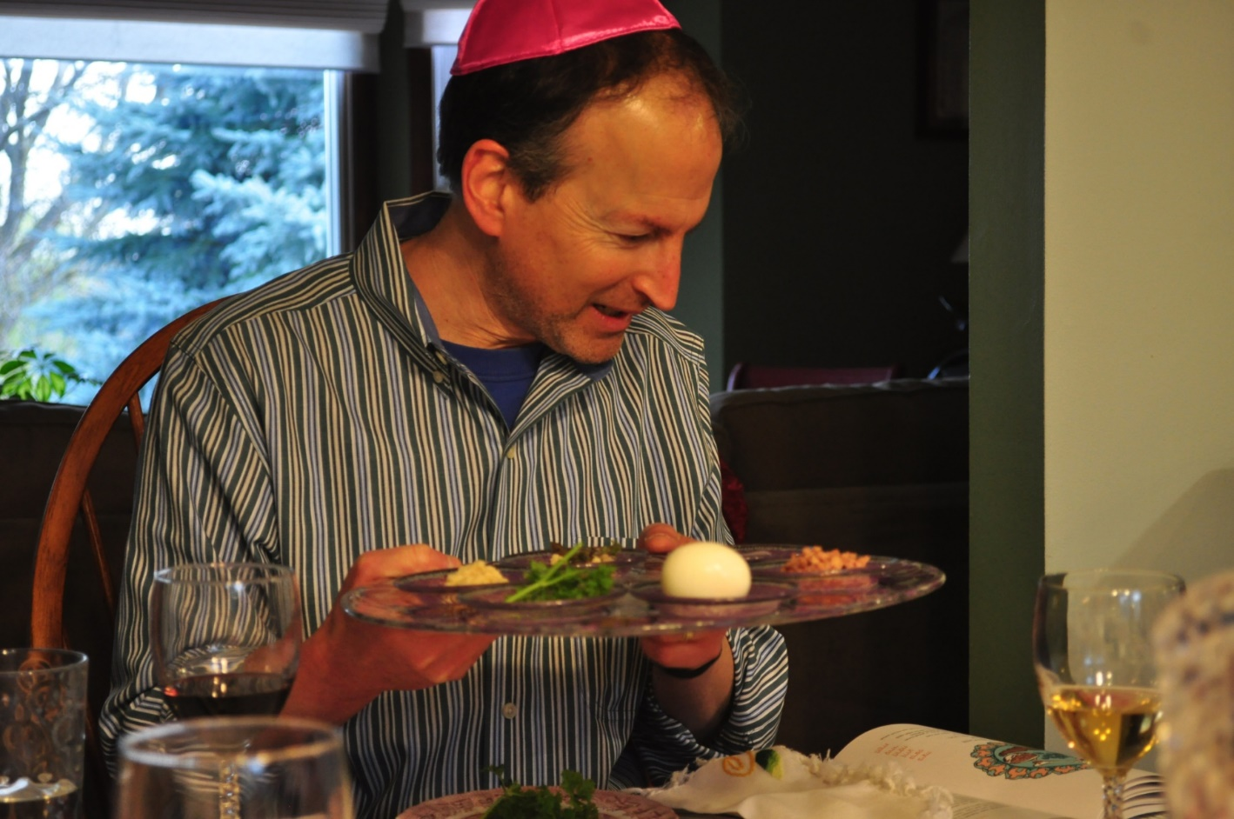
When Is Passover?
Passover is celebrated in spring by Jewish people.
Photo courtesy of danbruell(@flickr.com) - granted under creative commons licence - attribution

Slide 5
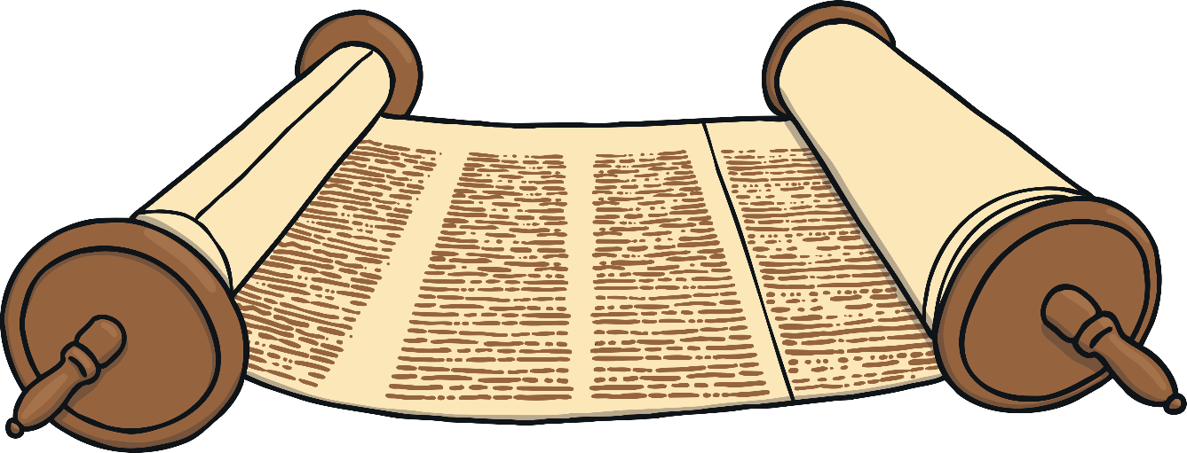
Why Is Passover Celebrated?
Passover is celebrated by Jewish people, who remember how the Israelite people were freed from slavery by Moses over 3000 years ago.
The story of Passover is in the Torah, the Jewish holy book.
Torah – Jewish holy book
Click on the words in bold to find out more.

Slide 6
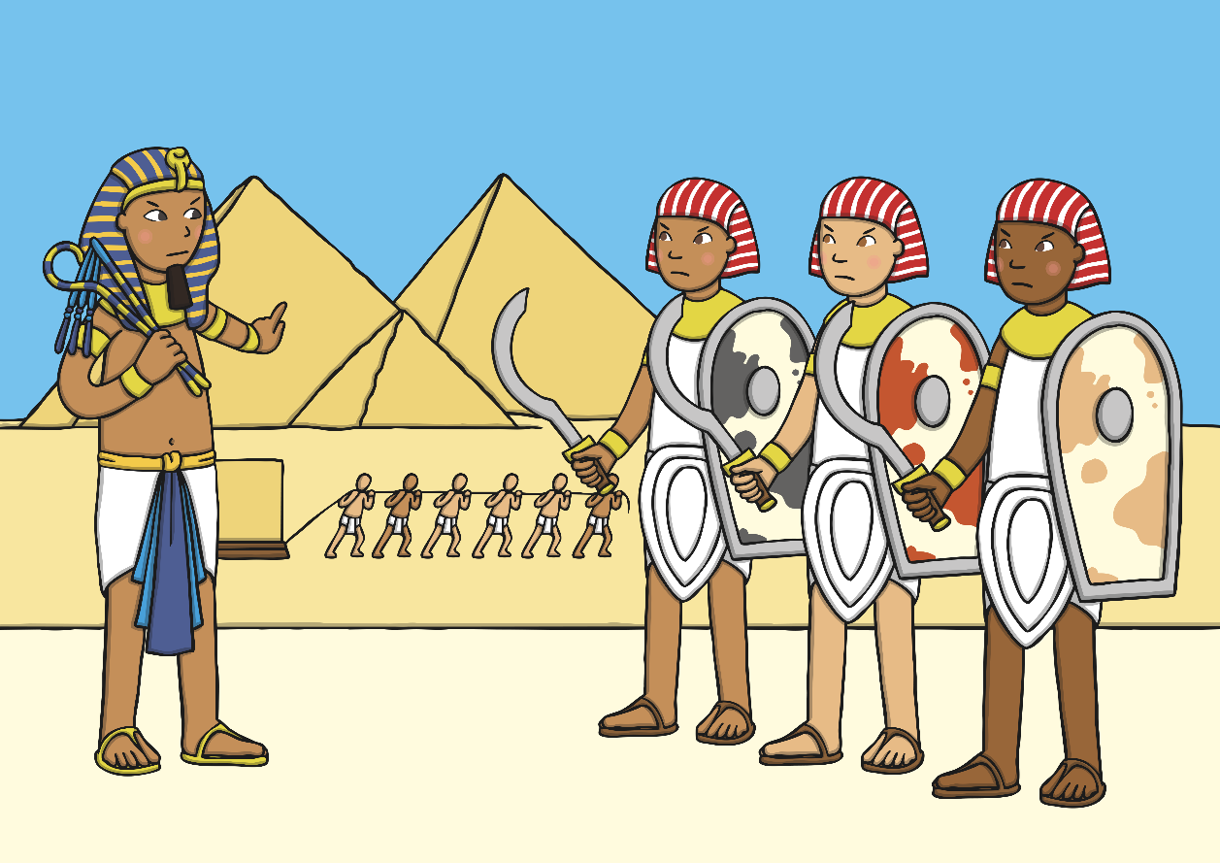
Moses
The Israelites were God’s chosen people.
They were enslaved by the Egyptian pharaoh and were forced to work hard and make buildings.

Slide 7
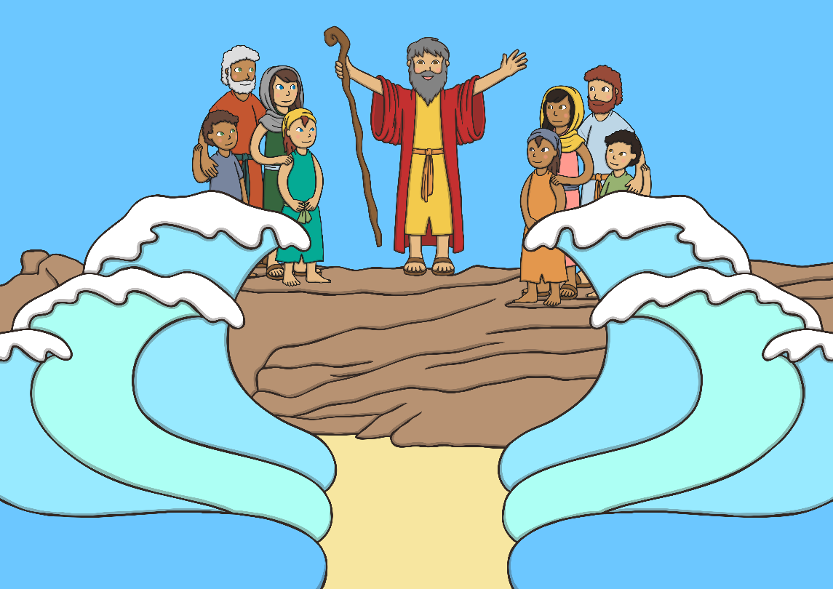
Moses
Moses was chosen by God to lead them into freedom. It was a long and difficult struggle. Eventually, Moses led the Israelites away from Egypt until they had to stop when they reached the Red Sea.
Then a miracle happened! Moses asked God for help, and the Red Sea parted.
The Israelites were saved! They were able to walk through the sea to freedom.

Slide 8
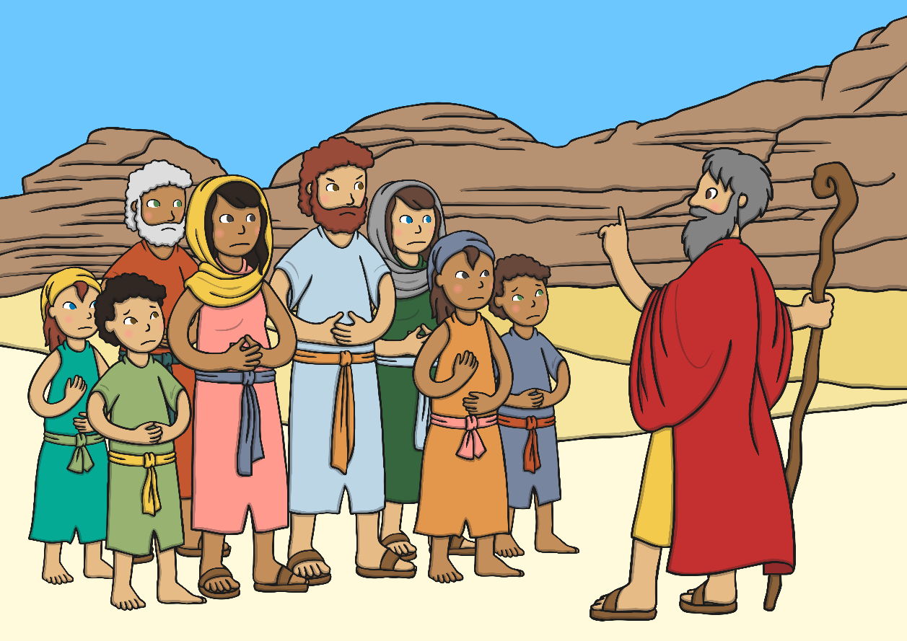
Moses
Moses and the Israelites spent many years travelling through the desert with no food and water.
God watched over them and provided for them.

Slide 9
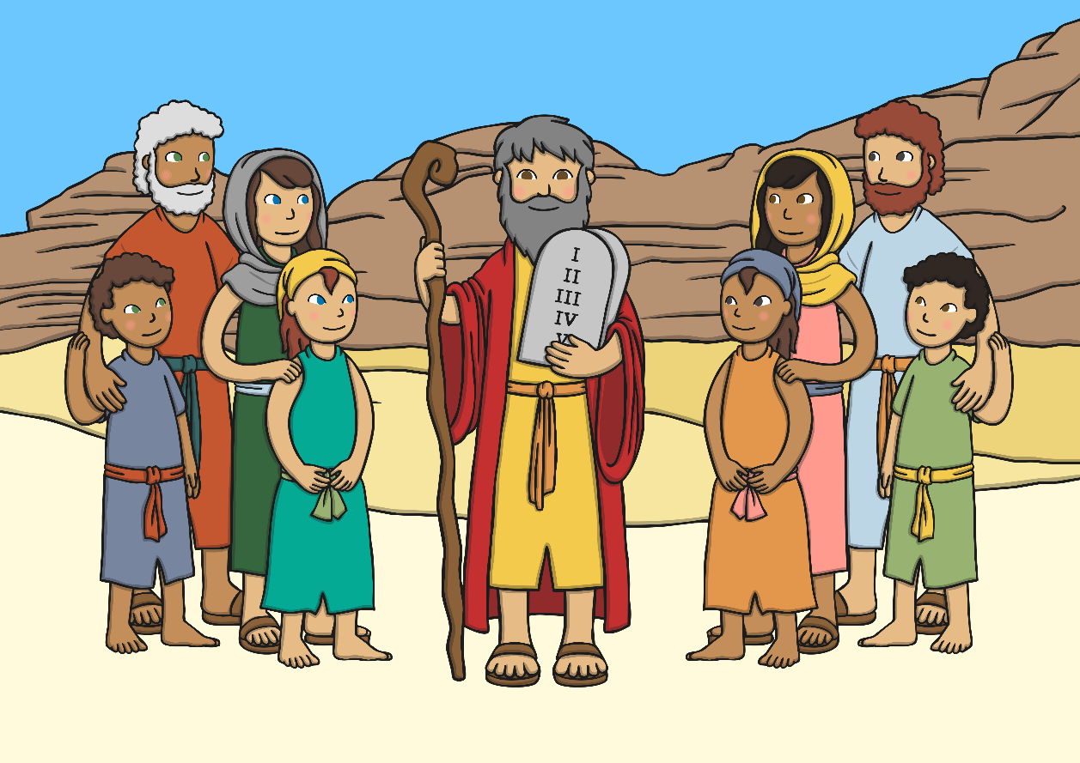
Moses
After three months, God gave Moses ten laws for people to live by.
These became the Ten Commandments.

Slide 10
How Is Passover Celebrated?
Passover is celebrated for seven or eight days.
On the evening before Passover begins, there is a special service called a Seder.
At the Seder meal there is a special Seder plate on the table.
Click on the words in bold to find out more.
Seder – means ‘order’ in Hebrew
Seder plate – an important part of the Seder meal, this plate has five sections to hold some special Seder foods.

Slide 11
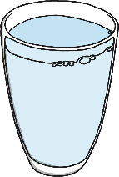
How Is Passover Celebrated?
Beitzah – a roasted, hard-boiled egg that represents sacrifice but also new life
Maror and chazeret – Two types of bitter herbs, reminding people of the bitterness of slavery
Karpas – a fresh green vegetable, often parsley, which symbolises the freshness of spring
Zeroa – A roasted lamb or chicken bone to symbolises offerings made to God
Charoset – a mixture of ground apples, nuts, ginger, cinnamon and wine, which symbolises the mortar used by the Israelites when they were forced to make bricks
Salt water – symbolizes the tears and sweat of enslavement

Slide 12
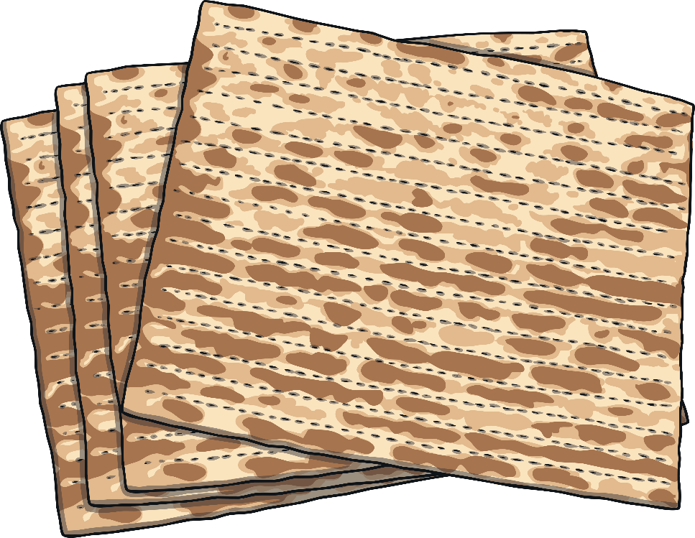
How Is Passover Celebrated?
At the Seder meal, three matzot breads are placed on top of each other.
The middle matzah is broken and the biggest piece is hidden.
Children hunt for the matzah and to win a prize.
Matzot – an unleavened bread
Click on the words in bold to find out more.

Slide 13
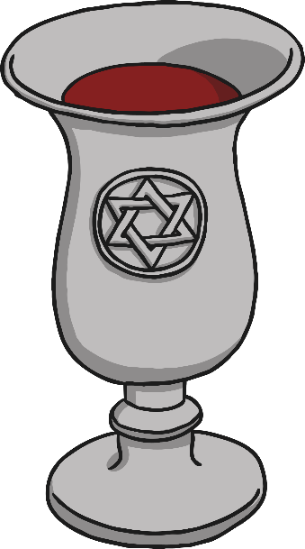
How Is Passover Celebrated?
Four small glasses of wine are drunk. People have different ideas about what this symbolizes.
Some people think that the wine is a symbol of freedom. They believe that the four cups represent four promises made by God to save and protect the Israelites.

Slide 14

How Is Passover Celebrated?
The story of how the Israelites fled from Egypt is retold at Passover.
It is read from a book called the Haggadah.
Haggadah – a special book from which the story of the Israelites fleeing Egypt is read.
Click on the words in bold to find out more.

Slide 15


How Is Passover Celebrated?
Everyone at the Seder has a cushion to lean on.
This is to remind them that the Israelites were freed from slavery to live a more comfortable life.

Slide 16

Try It!
Match the Pesach symbols to the descriptions.
A symbol of the freedom and comfort of the Israelites when they were released from slavery
Salt water
Maror
A symbol of the bitterness of slavery
Cushion
A symbol of the sweat and tears shed during slavery

Slide 17
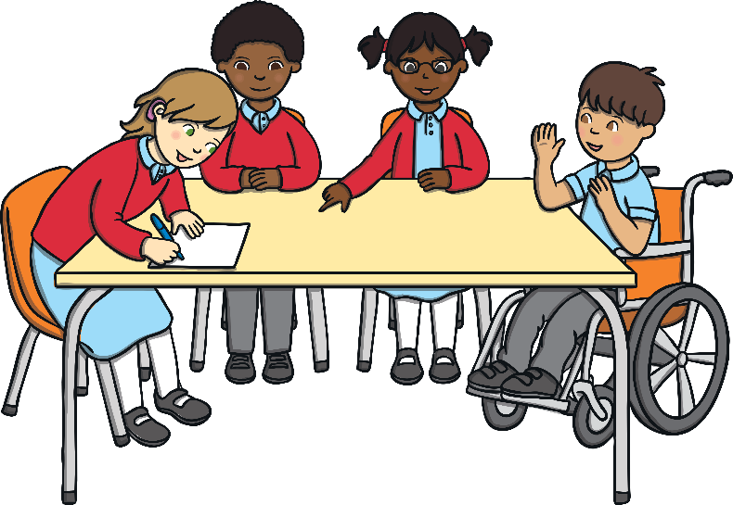
What Did You Find
Out about Passover?
Share your ideas with a partner.
Share your ideas with everyone.
What can
you remember about Passover?
Pair
Share
Think

Slide 18
Glossary
Haggadah – a special book from which the story of the Israelites fleeing Egypt is read
Hebrew – an ancient language that is the official language of Israel
Jewish – a person whose religion is Judaism
Judaism – one of the world’s oldest religions
Maror – a bitter herb eaten as part of the Seder meal
Matzot –an unleavened bread
Seder – means ‘order’ in Hebrew.
Seder plate – an important part of the Seder meal, this plate has five sections to hold some special Seder foods
Symbol – something that represents or reminds you of something else
Torah – Jewish holy book

