Slide 1





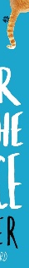



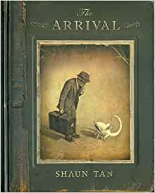
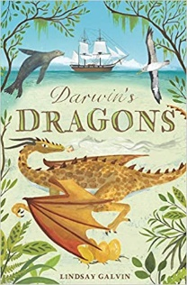


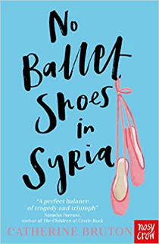


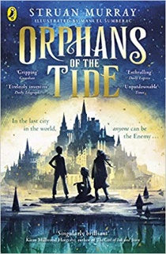
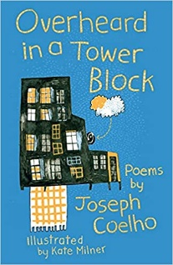


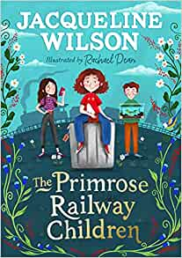
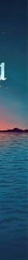
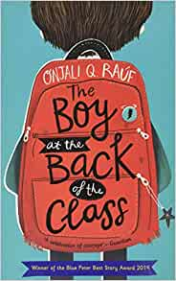

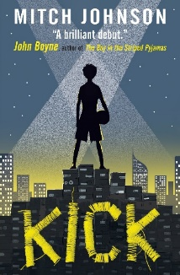
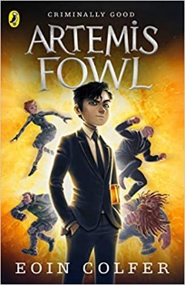


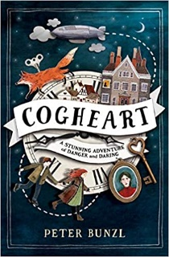
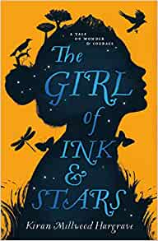

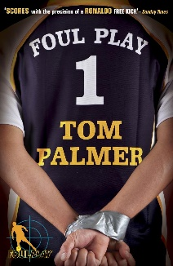
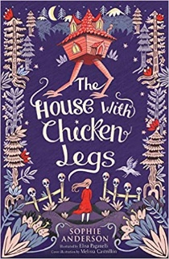
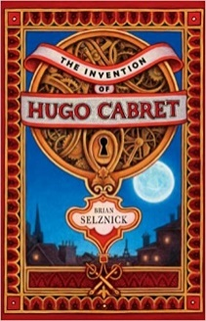

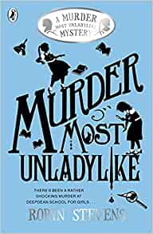
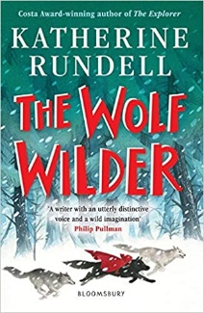




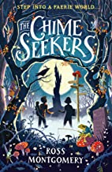
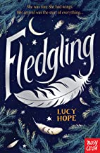
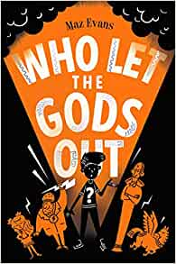

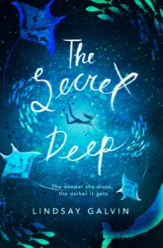


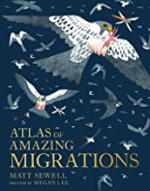
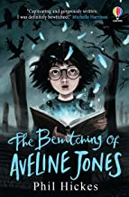

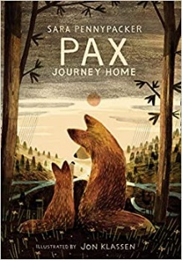
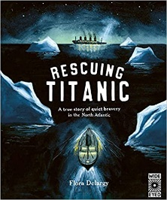
Search
Trending Now
Top Picks for You
New Releases
Notes:
Book covers are animated by row – to change the pictures without breaking the animation, right-click on the image and select ‘change picture’, then add your chosen book cover ☺
Jane Hill, Learning Resource Manager, Kings Langley Secondary School, 2019.

Slide 2




Who’s reading?
Girls
Boys
Teachers
Parents
Girls
Boys
Parents
Notes:
To add a hyperlink to a photo/image → right-click and click on ‘Hyperlink’ → right-hand size of box click ‘Place in This Document’ → click on slide number to hyperlink to → click ‘ok’
To remove a hyperlink → right-click and click ‘Remove Link’
If you insert a new slide between the existing slides the hyperlink will not be changed – it will remember which slide you wanted it to be linked to! Clever!

Slide 3
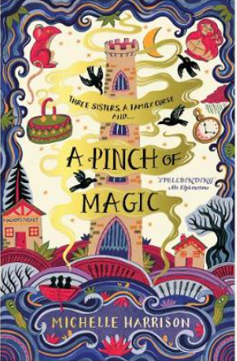

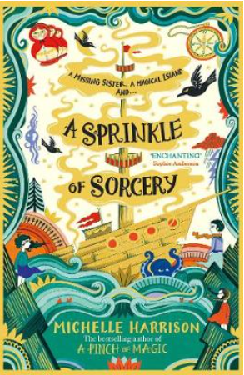
Switch User
Back to menu
Girls
Next book
A Pinch of Magic
Michelle Harrison
2019 Fiction Adventure Stories Fantasy/Magical Family
Three sisters trapped by an ancient curse. Three magical objects with the power to change their fate. Will they be enough to break the curse? Or will they lead the sisters even deeper into danger?
“A spellbinding story, steeped in Magic. I adored it.” – Abi Elphinstone,
author of Sky Song
Also by this author:
This is the front cover.
Notes:
Front cover images, book synopsis and review taken from lovereading4schools.co.uk

Slide 4


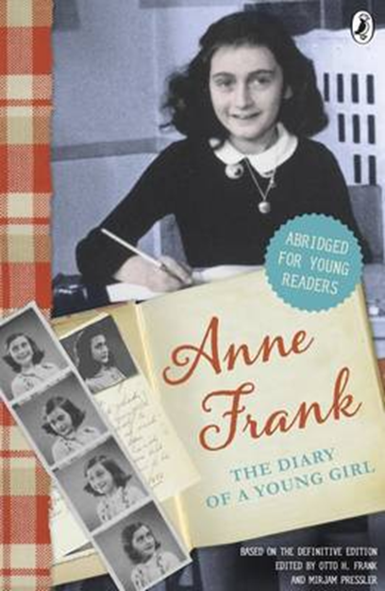
Switch User
Back to Menu
Year 3
Next book
You Are A Champion
Marcus Rashford
2021 Non-Fiction Football Inspirational Biography
It’s hard to know what is possible until you start. You have to be able to dream big and be prepared to work towards your dreams. Good things take time. I’ve achieved a lot, but it didn’t come in one go – big things rarely happen overnight, and good things rarely happen as if by magic . .” Marcus Rashford
Other biography
Recommended by Charlotte G
Notes:
Front cover images, book synopsis and review taken from lovereading4schools.co.uk

Slide 5
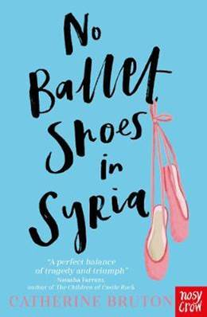
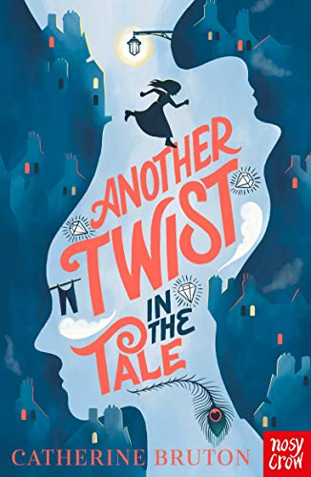
Switch User
Back to Girls
Year 3
Next book
No Ballet Shoes In Syria
Catherine Bruton
2021 Fiction Contemporary Inspirational Family
No Ballet Shoes in Syria is an awesome book to read,but don’t be put off by the fact it is a book about the Syrian war. This is also a good book to read because it shows that friendship can be made no matter what race , religion or how rich you are.
Also by this author:
Recommended by Ezmai
Notes:
Front cover images, book synopsis and review taken from lovereading4schools.co.uk

Slide 6

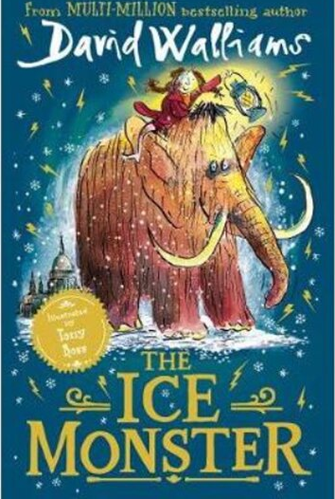
Switch User
Back to Girls
Year 3
Next book
Fing
David Walliams
2019 Fiction Adventure Comedy
Mytrle Meek has everything she could possibly want. But everything isn’t enough. She wants more, more, MORE! When Mytrle declares she wants a Fing , there’s only one problem… What is a FING?
Mr and Mrs Meek will do anything to keep their darling daughter happy, but will they ever find a FING?
Recommended by Evelyn and Cody
Notes:
Front cover images, book synopsis and review taken from lovereading4schools.co.uk

Slide 7


Switch User
Back to Menu
Year 3
Next book
Guinness World Records 2022
2022 Non-Fiction Factual Amazing Family
Fully revised and updated, and with a bright new design, Guinness World Records 2022 provides a fascinating snapshot of our world today. We also want to encourage readers to put their own record-breaking to good, so look out for projects that might inspire you to make a difference – so don’t just Discover Your World, Change Your World!
You might also like:
Recommended by Cody, Freddie and Rhys
Notes:
Front cover images, book synopsis and review taken from lovereading4schools.co.uk

Slide 8


Switch User
Back to Menu
Year 3
Next book
Danny Champion Of The World
Roald Dahl
2016 Fiction Heart-warming Adventure
Danny lives in a gipsy caravan with his father, the most marvellous and exciting father any boy ever had. All the land around them belongs to Mr Victor Hazell, a rich snob with a great glistening beery face and tiny piggy eyes. Nobody likes him, not one-little bit. So one day, Danny and his father concoct a daring plot that will give the old blue-faced baboon Victor Hazell the greatest shock of his life - so long as they don't get caught.
Also by this author:
Recommended by Jacob and Mrs Moffett
Notes:
Front cover images, book synopsis and review taken from lovereading4schools.co.uk

Slide 9


Switch User
Back to Menu
Year 3
Next book
Kensuke’s Kingdom
Michael Morpurgo
2016 Fiction Heart-warming Adventure
“I heard the wind above me in the sails. I remember thinking, this is silly, you haven’t got your safety harness on, you haven’t got your lifejacket on. You shouldn’t be doing this . . . I was in the cold of the sea before I could even open my mouth to scream.”
Washed up on an island in the Pacific, Michael struggles to survive on his own. With no food and no water, he curls up to die. When he wakes, there is a plate beside him of fish, of fruit, and a bowl of fresh water. He is not alone…
Also by this author:
Recommended by Mr Birchenough
Notes:
Front cover images, book synopsis and review taken from lovereading4schools.co.uk

Slide 10
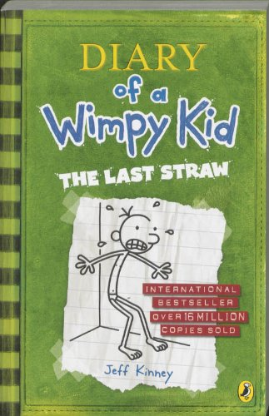
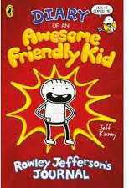
Switch User
Back to Menu
Year 3
Next book
Diary of a Wimpy Kid
Jeff Kinney
2016 Fiction Comedy American Middle School
You know how you're supposed to come up with a list of "resolutions" at the beginning of the year to try to make yourself a better person? Well, the problem is, it's not easy for me to think of ways to improve myself, because I'm pretty much one of the best people I know. But Greg's dad has other ideas.
Also by this author:
Recommended by Jack Garrity
Notes:
Front cover images, book synopsis and review taken from lovereading4schools.co.uk

