Slide 2


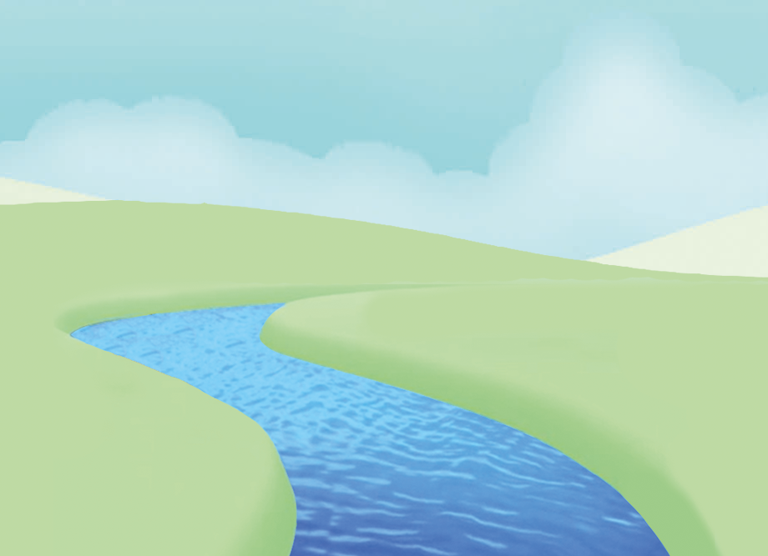



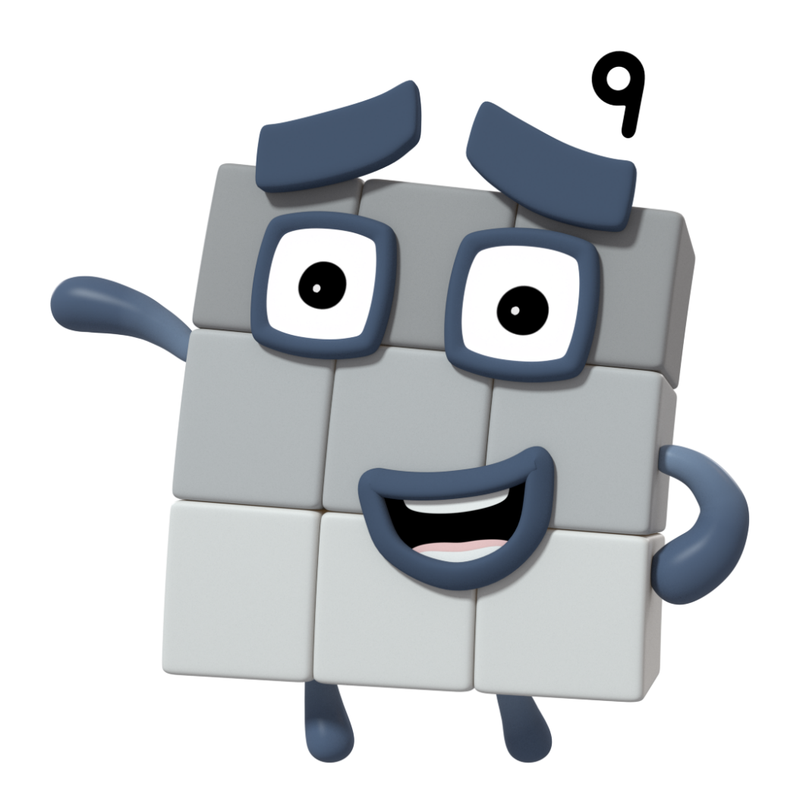






next
What do you notice about me? What shape am I?

Slide 3
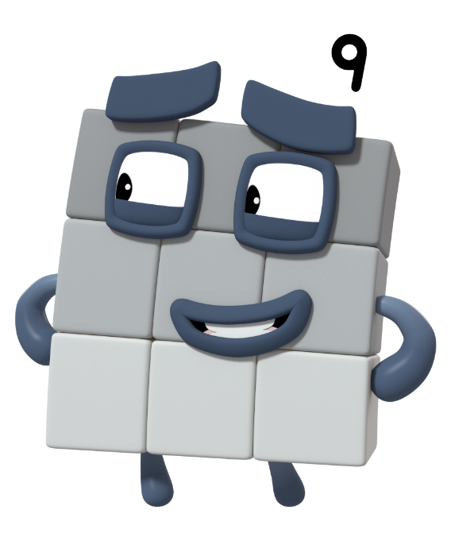
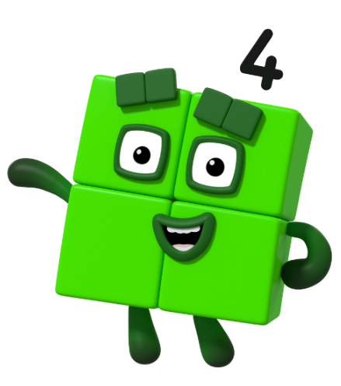
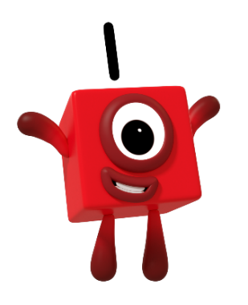
next
We are all square, but how are we different?
I am three blocks tall and three blocks wide.
I am two blocks tall and two blocks wide.
I am one block tall and one block wide.
?
?
?

Slide 4

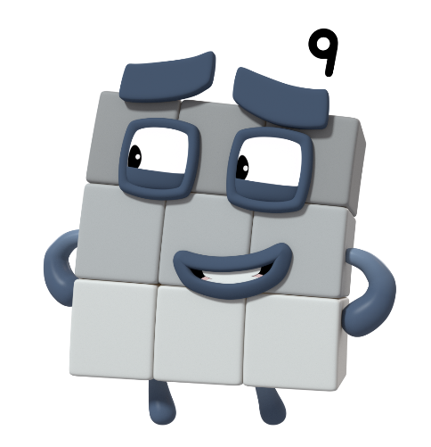
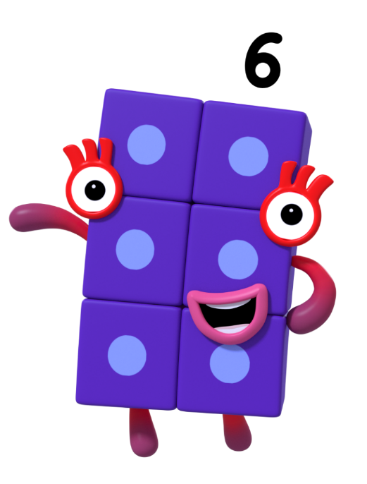
next
Look at the Numberblock. Is it square like me?
No. I’m not a square!
Try again.
yes
no

Slide 5
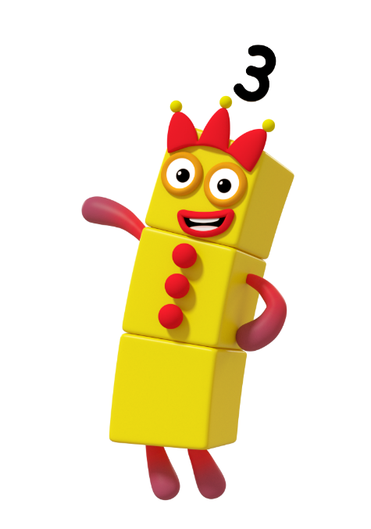
next
Look at the Numberblock. Is it square like me?
No. I’m not a square!
Try again.
yes
no

Slide 6
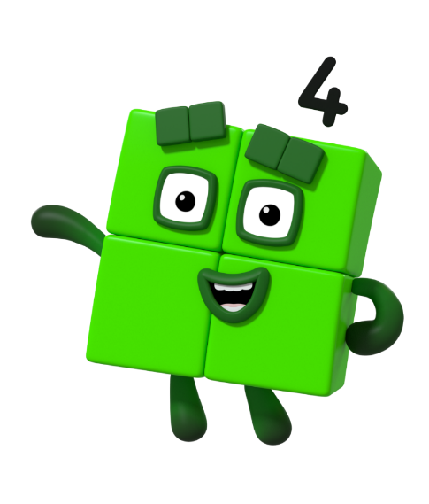
Look at the Numberblock. Is it square like me?
Try again.
yes
no

Slide 7

next
I am two blocks tall and two blocks wide.
Yes. I’m a square!

Slide 8
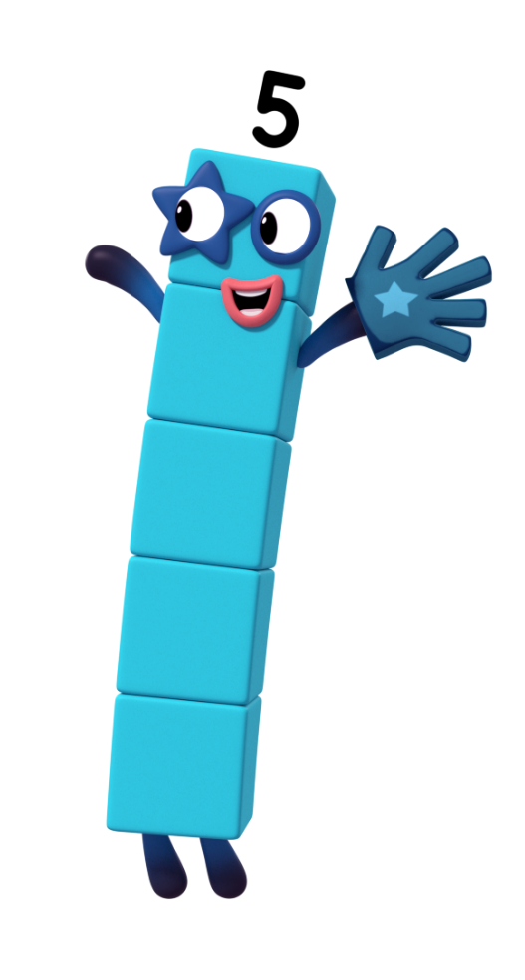
next
Look at the Numberblock. Is it square like me?
No. I’m not a square!
Try again.
yes
no

Slide 9

Look at the Numberblock. Is it square like me?
Try again.
yes
no

Slide 10
next
I am one block tall and one block wide.
Yes. I’m a square!

Slide 11
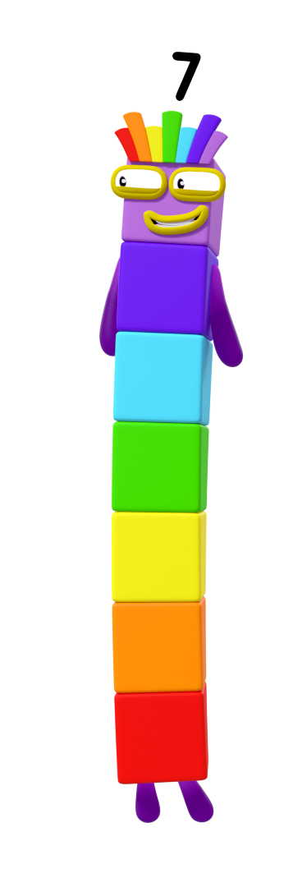
next
Look at the Numberblock. Is it square like me?
No. I’m not a square!
Try again.
yes
no

Slide 12
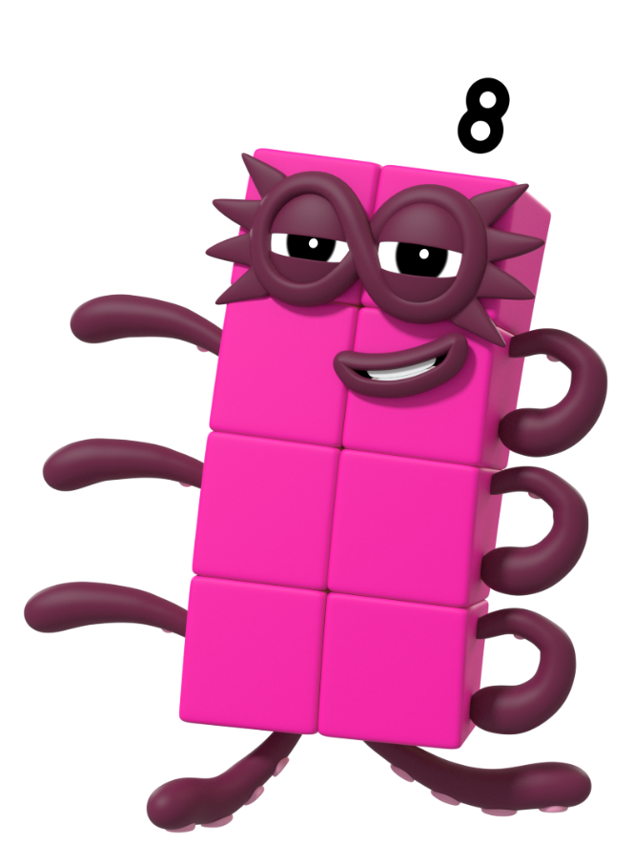
next
Look at the Numberblock. Is it square like me?
No. I’m not a square!
Try again.
yes
no

Slide 13
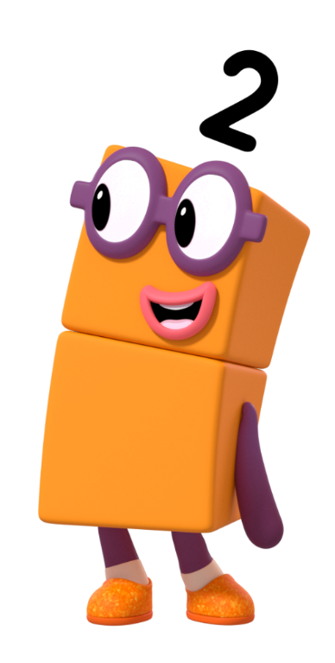
next
Look at the Numberblock. Is it square like me?
No. I’m not a square!
Try again.
yes
no

Slide 14

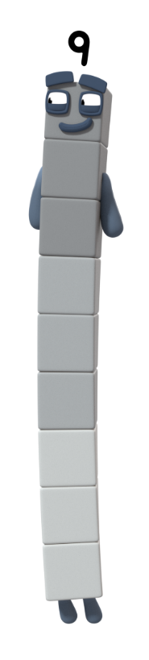
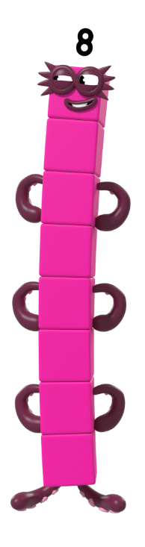


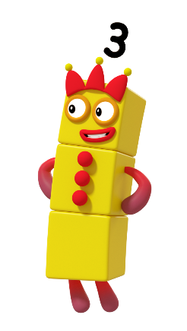

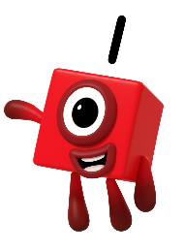

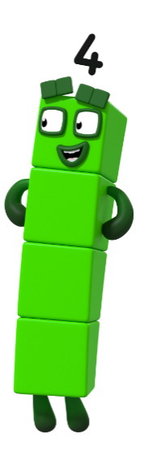
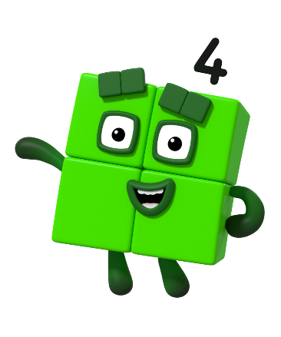
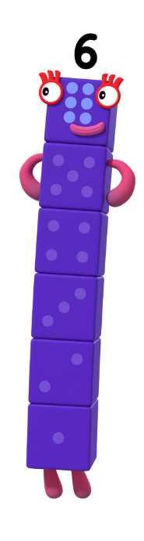

next
Click on the Numberblocks that can make a square.

Slide 15


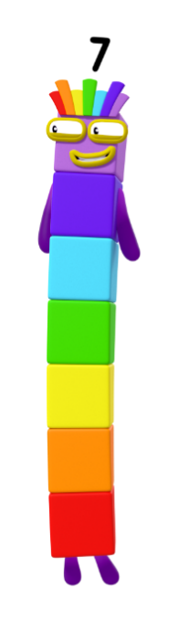







finish
Click on the Numberblocks to sort them correctly.
I cannot make a square
I can make a square

Slide 16
Goodbye!
For more number fun, head on down to learningblocks.tv!

