Slide 1
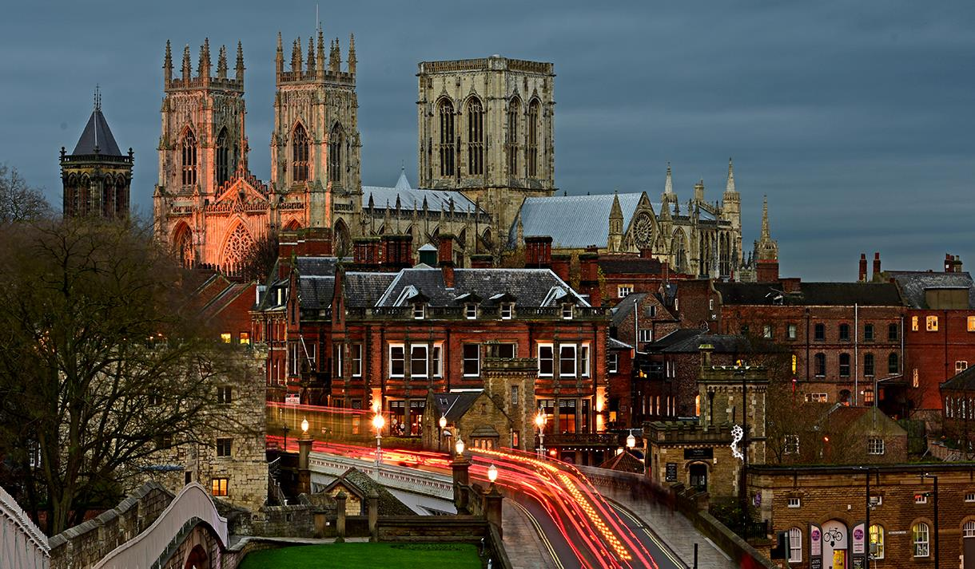
The Berkeley academy year 6
York visit 2026

Slide 2
Staffing
Mr Birchenough
Mr Wagg
Mrs Winstone
Miss Doran
Others TBC

Slide 3
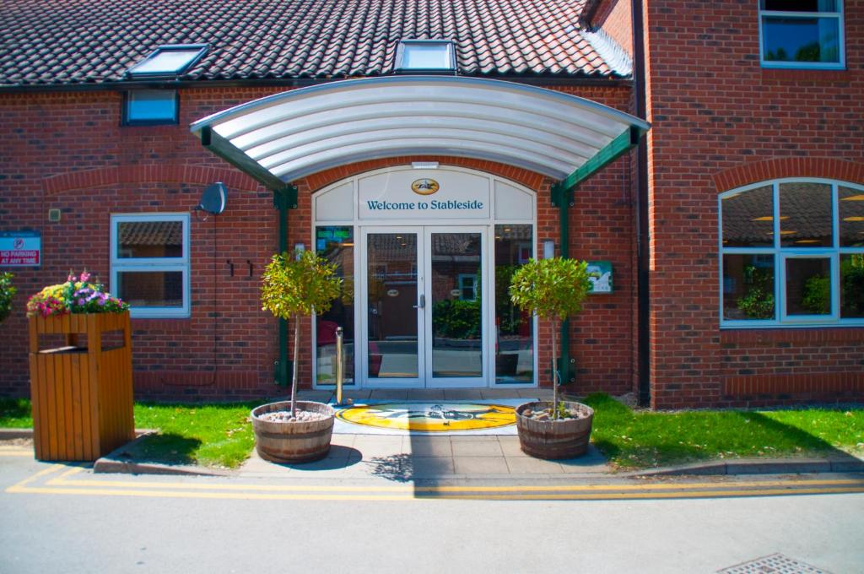
Accommodation
We shall be staying at Stableside York

Slide 4
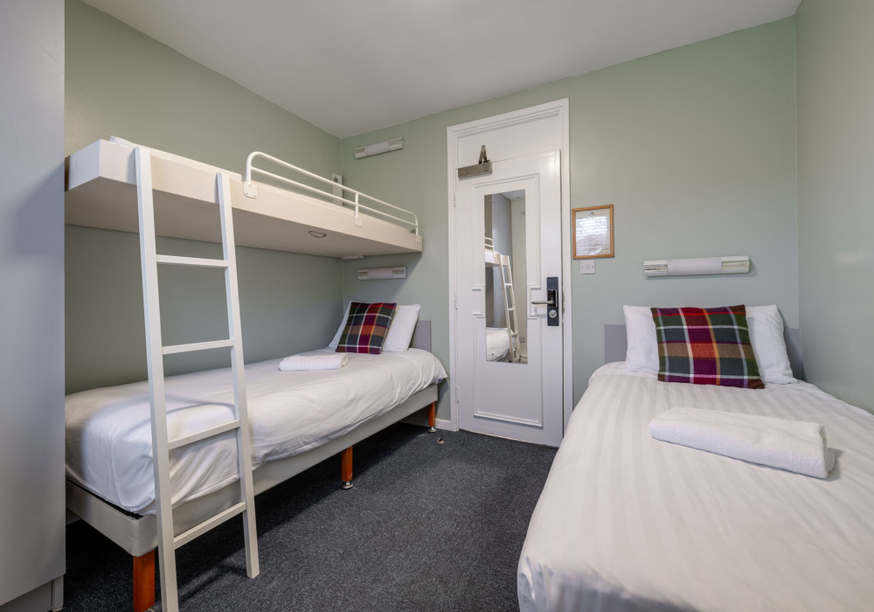
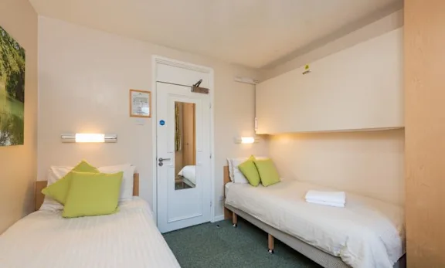
Stableside York –
Accommodation

Slide 5
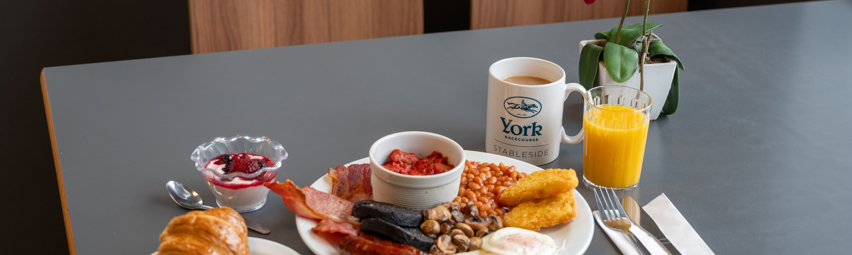
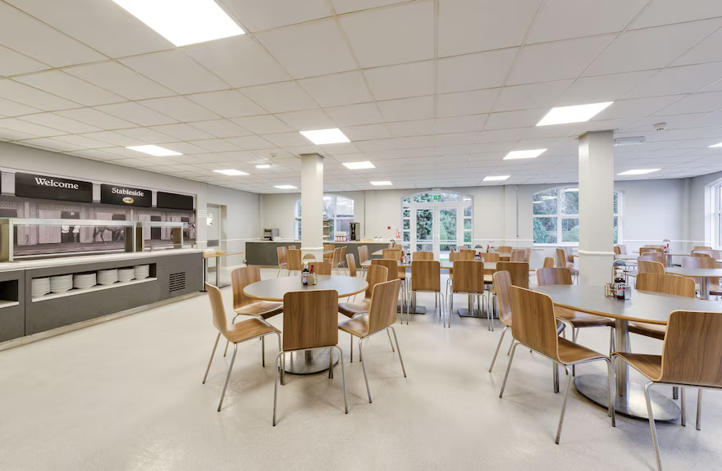
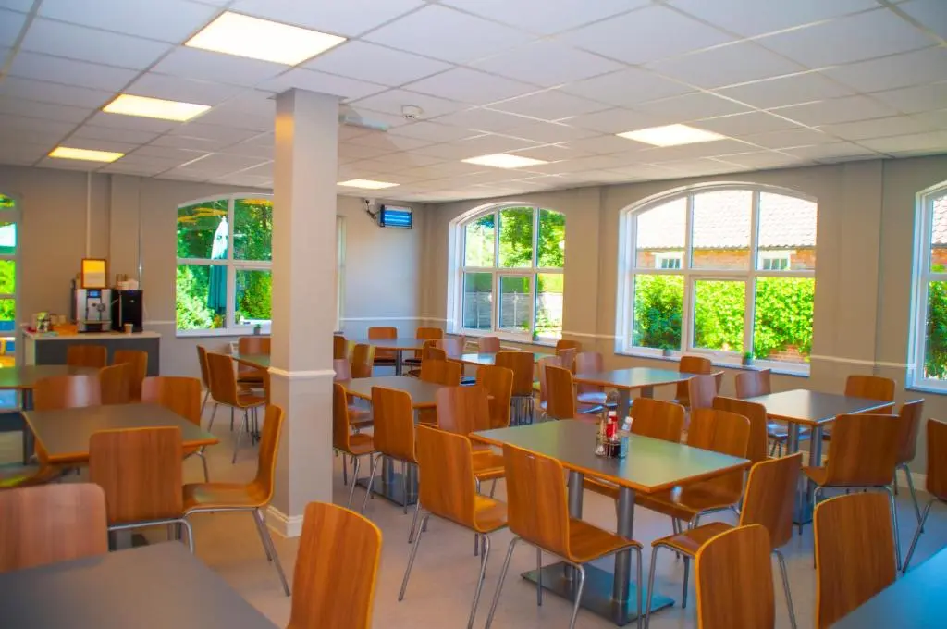
Food!

Slide 6
Why York?
The York visit became a Berkeley ‘tradition’ until 2010. The visit, which was once a Year 5 activity, was run for many years and was popular with both children and staff alike. In 2015 we started visiting York again and this year will be the 34th visit by Berkeley children to the city!
The aim of the visit remains the same: Children have the opportunity to develop self confidence and independence, which will be essential as they move up to secondary school.
It also gives some parents a brief period of respite!

Slide 7
Travel
We shall be travelling with Meredith’s (Lakeside) Coaches. We shall assemble in the school hall by 8:15 a.m. on the morning of 18th May, ready to depart by 8:45 at the latest.
We will be taking a very short toilet stop en-route. This is to be arranged with the coach company and will depend on traffic.
For our return, the coach will travel up to York and meet us at the hotel before returning to school late afternoon. Again, we will be taking a toilet break on the return journey.

Slide 8
Itinerary: Monday 18th May
8:15 Assemble in School Hall with luggage and own packed lunch.
8:30 Leave for York by coach
12:00 Arrive in York – check-in at Stableside, eat lunch.
1:00 Leave for Castle Museum 2:00 – 3:30
5:00 Arrive back to Stableside – own time in rooms – relax, freshen up.
5:30 Evening meal in restaurant
8:00 Ghost tour with Mad Alice starts at Micklegate (leave hotel by 7:00 at latest) TBC
9:45 Up to rooms – get sorted for bed.

Slide 9
Itinerary: Tuesday 19th May
7:00 Teachers give the wake up call!
7:30 Down to lounge
7:45 Breakfast
8:45 Assemble in lounge, complete with bag, workbook, pencils, money etc.
9:00 Leave for York Minster –
Group A - entry at 10.30am
Group B – entry at 10.45
12:00 Group A assemble outside the West Door of York Minster
12:15 Group B assemble outside the West Door of York Minster
Lunch
1.30 Assemble to leave for Railway Museum
2.30 Tour of Railway Museum
5:30 Arrive back at hotel – own time in rooms – relax, freshen up, TV.
6:00 Evening meal
7:15 Use of grounds at Stableside
9:30 Up to rooms…tired!

Slide 10
Itinerary: Wednesday 20th May
7.15 Wake up call
7.30 Lounge then breakfast
8:45 Assemble in lounge with bags packed
9.00 Group A - Leave for York Chocolate Story 10:00 – 11:15
9:00 Group B – Leave for York Chocolate Story 10:15 – 11:30
9.00 Group C – Leave for York Chocolate Story 10.30 – 11.45
12.00 Lunch in York and proceed back to hotel to collect belongings
1.30 Leave by coach for home
4.00* Arrive back at school

Slide 11
Kit List
Packed lunch for Monday 18th May, including drinks for the day
Medicines if required in a labelled bag – please also complete a medicine form and bring this on the day we depart. Please no medicine will be given if there is not a completed medicine form.
At least 2 complete changes of clothing for the day, plus a change of clothes for the evening activities (this is optional)
Jumpers/ t-shirts/ trousers/ underwear/ socks
2 pairs of comfortable shoes that will be suitable to walk in throughout the day. Please be aware we will be out from 9am- 4.30pm and then out again from 7.30-9.00pm and will be walking around the city all day, so comfy shoes are essential!
A pair of shoes/slippers for the indoor activities
Pyjamas
Toiletries and a Towel – no spray deodorants please, just roll-ons
Plastic bag for dirty clothes
A plastic bottle which can be refilled for drinks throughout the day

Slide 12
Kit List
A small back pack or rucksack which children will use to carry their lunch and other essentials during the day
Cap or hat in warm weather
Sun cream
A maximum of £10.00 spending money preferably in a purse/wallet. Staff will not be taking any responsibility for this money and therefore children will need to ensure it is looked after.
A waterproof coat (hopefully this won’t be needed!)
NO mobile phones or tablets are allowed. Any mobile phone or tablet that is taken will be confiscated until the end of the visit and only returned when we come back to school.
A camera can be taken but we recommend a disposable camera which should be clearly labelled with the child’s name. The school will take no responsibility for any lost or damaged items.
A teddy or snuggly toy
Books/ colouring/ games for room/evening activities, e.g. cards, Uno or dominoes

Slide 13
Risk Assessments
Trips such as this do not plan themselves! In order to run this visit, planning started last term. As staff, we have to be able to satisfy both the school governing body and Cheshire East Borough Council that appropriate risk assessments have been undertaken to ensure the safeguarding of ALL participants – and that those risk assessments are fit for purpose. Mr Birchenough has completed visits to the city and all risk assessments for each venue, along with those for accommodation and travel arrangements have been passed by the risk assessment team. However. . .

Slide 14
Risk Assessments 2
Whilst we will do everything possible to ensure the safety of the children during the visit, there is a reciprocal expectation.
Behaviour on school visits at The Berkeley – including residentials, has always been consistently exceptional and has always been recognised as such. In order to ensure that children are kept safe, it is expected that behaviour will, at all times be excellent.
We must be clear that in the case of any behaviour which threatens the safeguarding of others (or disrupts the ability of the staff to ensure safeguarding whilst acting in loco parentis) will result in parents being contacted. In such a circumstance, parents would be expected to remove their child from the visit. The understanding will be that this is a non-negotiable.

Slide 15
Medicines
Please note that in order to administer any medicines, staff must have a signed consent form. Unfortunately staff cannot administer any form of medication without a signed form. Please do make sure that this has been completed in advance of the visit, with dosage times and frequency clearly marked. Medicines should be brought on the day of departure and handed directly to the class teacher.

