Slide 1
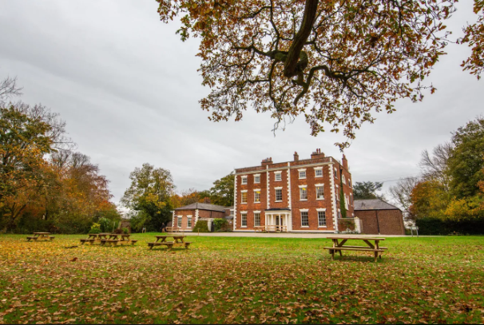
Year 4 Residential
2026

Slide 2
Dates
Class 10
Leaving on Wednesday (9.30am) and returning on Thursday (3.20pm)
Class 9
Leaving on Thursday (9.30am) and returning on Friday (3.20pm)

Slide 3
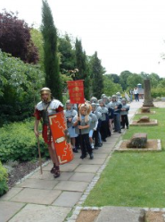
Roman experience
The popular Roman school trip is ‘The Roman Empire and It’s Impact on Britain’. This session is designed to help pupils explore life in Roman times and investigate the Romanisation of Britain. The day includes:
Interactive session
Tour around the museum
A march with a Roman soldier around his fortress home
Lunch – please provide packaging that can be binned/recycled

Slide 4
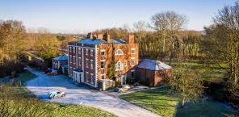
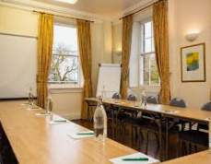
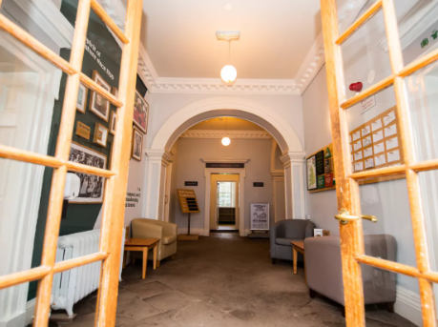
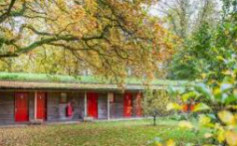
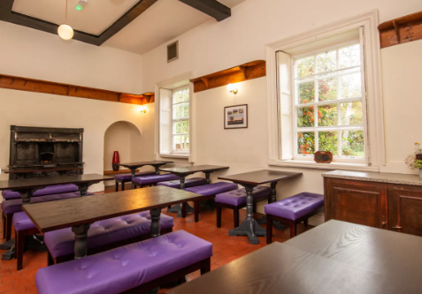
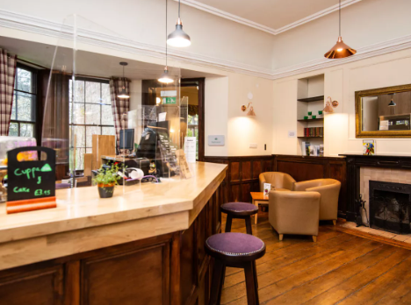

Slide 5
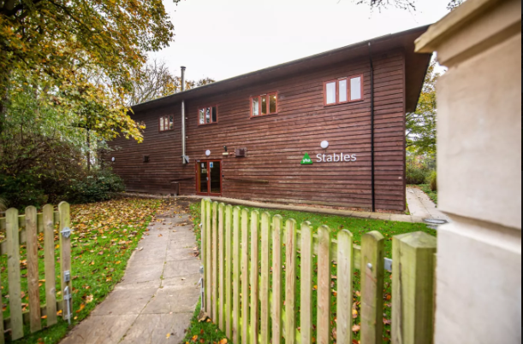
Arrival
Children will be given a health and safety briefing, shown around the building and taken to their rooms.

Slide 6
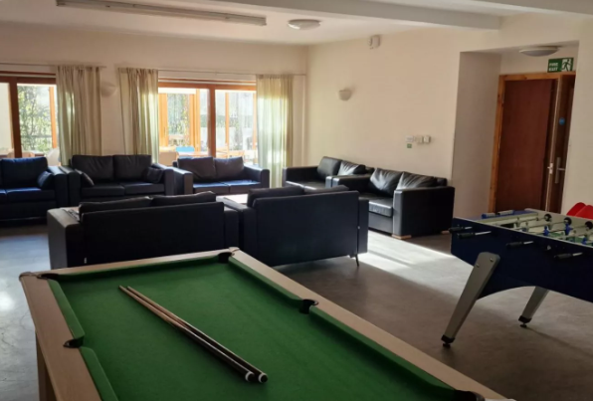
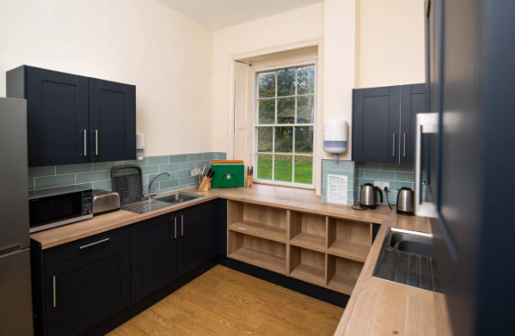
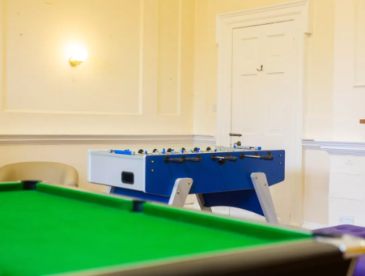
Water bottles empty in bag
No sweets/treats in own bags! No midnight feasts!!!!
Kitchen so children will be able to have cold/warm drinks & a biscuit.

Slide 7
Sleeping
Rooms will be groups of 4, in bunk beds based on their friendship choices. Boys/girls separate. The children have chosen who they would like to be with – explain!
Each room has its own ensuite.
Children will be shown where the teachers will be sleeping.
We are the only school in the building.

Slide 8
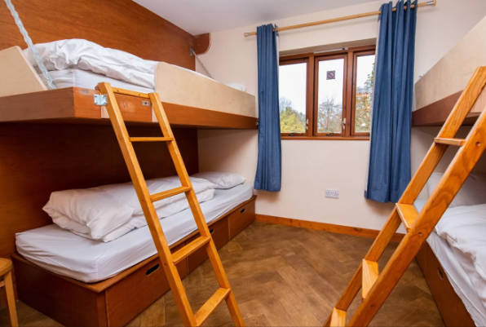
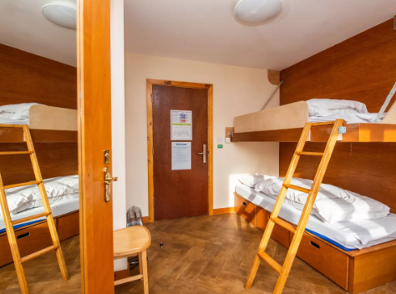
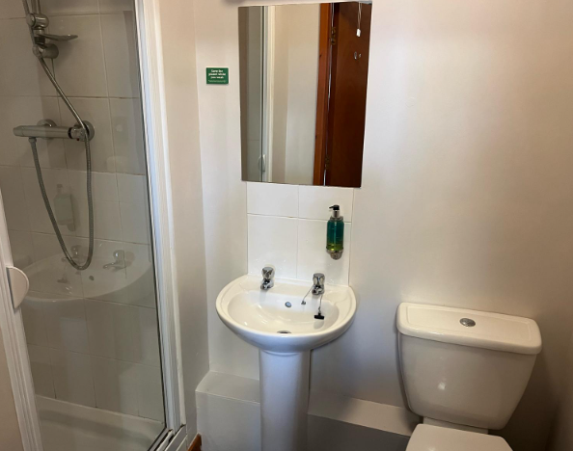

Slide 9
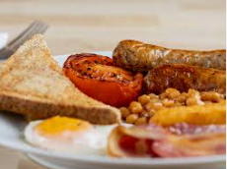
Food
Children will bring a packed lunch from home/school for the first day. All other food is provided. Please bring in packaging that can be thrown away/recycled.
Breakfast- The YHA breakfast consists of a continental buffet from which you may help yourself and a full/vegetarian English breakfast served by the YHA team. They do not require breakfast choices in advance.

Slide 10
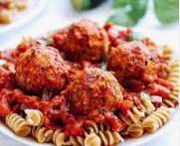
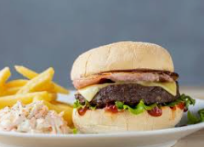
Evening meal - There is a wide choice children can choose from.
Class 10
Meatballs in a tomato sauce with pasta and garlic bread
Pasta & Veggie meatballs with garlic bread (v)
Jacket Potato with Cheese and Beans (V)
Chocolate fudge cake
Fresh fruit (v)
Class 9
Cheese burger and fries
Crispy Bean Burger and Fries (v)
Jacket Potato with Cheese and Beans (V)
Waffles and caramel sauce and cream (v)
Fresh fruit (v)

Slide 11
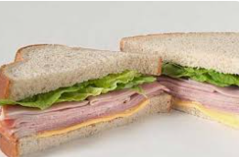
Lunch - Second day - Children will choose their sandwich choice for lunch
Ham on white bread 246kcal
Cheese on white bread 335kcal
Egg Mayo on white bread 334kcal
Chicken Mayo in malted bread 328kcal
Tuna Mayo in white bread 329kcal
Halal Chicken Tikka 427kcal
Vegan Cheese & Pickle 348kcal
Gluten Free Cheese & Onion 396kcal
*This will include a bag of crisps, biscuit bar and piece of fruit.
*All dietary needs will be sent prior to our visit to allow them to cater for everybody.

Slide 12
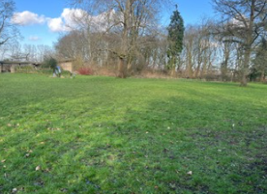
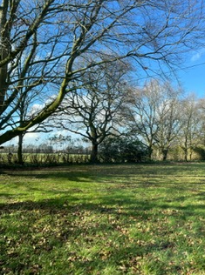
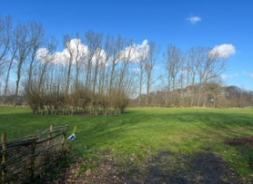
Activities
PE – Outdoor activities
* Rounders
*Football
Art – Maurice Sendak
(Teddy)
We will take a range of art and sports equipment

Slide 13
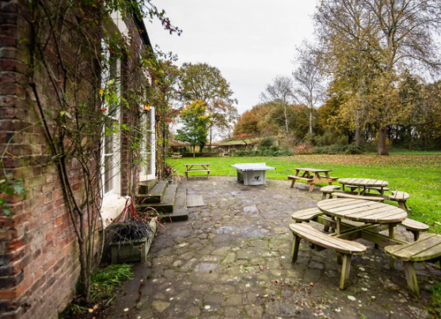
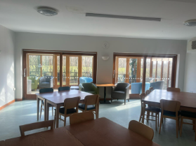
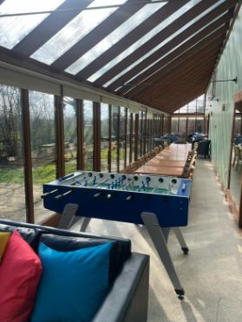
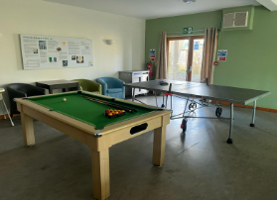
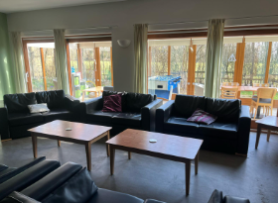
Free Time

Slide 14
Kit List
Children may spend a lot of time outdoors.
Waterproof coat
Clothes that you don’t mind getting muddy
2 pairs of shoes- inside shoes (sliders/slippers/crocs) and outside shoes that may get dirty.
Warm pyjamas
Toiletries
Children do not need to bring any electronics like phones, cameras, iPads or any other electronic devices.
No toys
Teddy/ home comfort
Refillable water bottle

